Slide 1







Technology Planning and Acquisition
-A journey from break/fix to planned replacement
Dean Skillicorn, Manager, Health Technology Management, Imaging Services
Valerie Timm, Capital Portfolio Manager
St. Luke’s Health System
Boise, Idaho

Slide 2
Overview
Introduction
Technology Management Strategy
Technology Assessment and Prioritization Criteria
How to Implement in Your Own Organization
Tips for Pitching an Equipment Replacement Plan
Q&A

Slide 3







St. Luke’s Health System
Serving Southern Idaho, Eastern Oregon and Northern Nevada
As the only Idaho-based, not-for-profit, community-owned and community-led health system, St. Luke’s is dedicated to our mission to improve the health of people in the communities we serve.

Slide 4
Break/Fix Technology Management Strategy
“The Old Way”
Annual process to request capital by facility, each department receiving top 1-3 priorities depending on cost
→ Difficult to prioritize imaging equipment and creates a deficit of new technology
No transparency into long term investment needs for financial planning
→ Leads to reactive replacement plans, break/fix approach adds disruption in patient care, dissatisfaction for staff and higher repair costs
Limited coordination to standardize equipment selection across the system
→ Increased cost of service, reduced ability to rotate clinical and biomed techs across sites, reduced supply chain’s leverage to negotiate better terms

Slide 5
Evolving a Technology Management Strategy
Current State Progression
Leverage HTM team to consult on front end replacement replanning
Outlined multi-year replacement roadmaps for proactive and predictable capital replacement plans
Implemented a technology platform to track prioritization plans and move away from spreadsheets
Created a review cycle for all modalities to continuously refresh replacement plans

Slide 6
Imaging Modality Review Cycle
Established a 3-month review period for each modality led by HTM to validate data
Department leaders then review and confirm prioritization for replacement within the modality
Capital Portfolio Manager facilitates final prioritization exercise and creates replacement plan justification for executive approval
Finance and Executives endorse or modify recommendations for inclusion on the capital plan
Supply Chain engaged vendors for equipment selection, negotiation and installation with approved replacement plan
Re-review the modality replacement plan annually

Slide 7
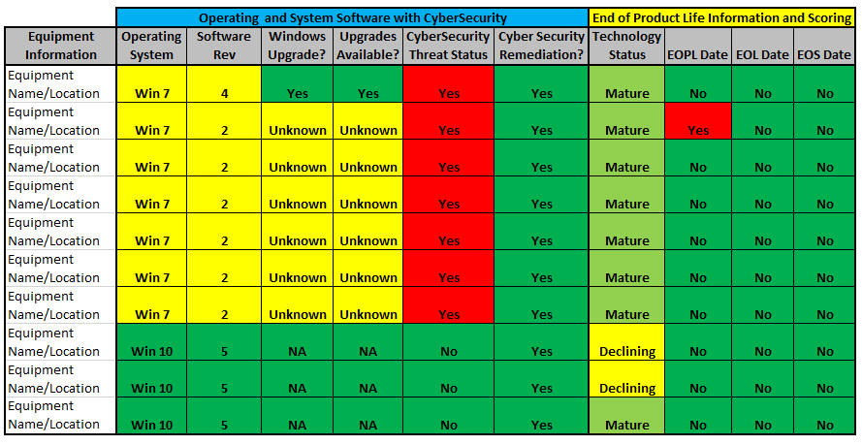
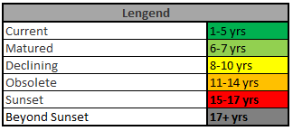
Implementing Imaging Replacement Roadmap
Technology Assessment
End of Product Life (EOPL/EOM)
End of Life (EOL)
End of Service Life (EOSL)/EOS)

Slide 8
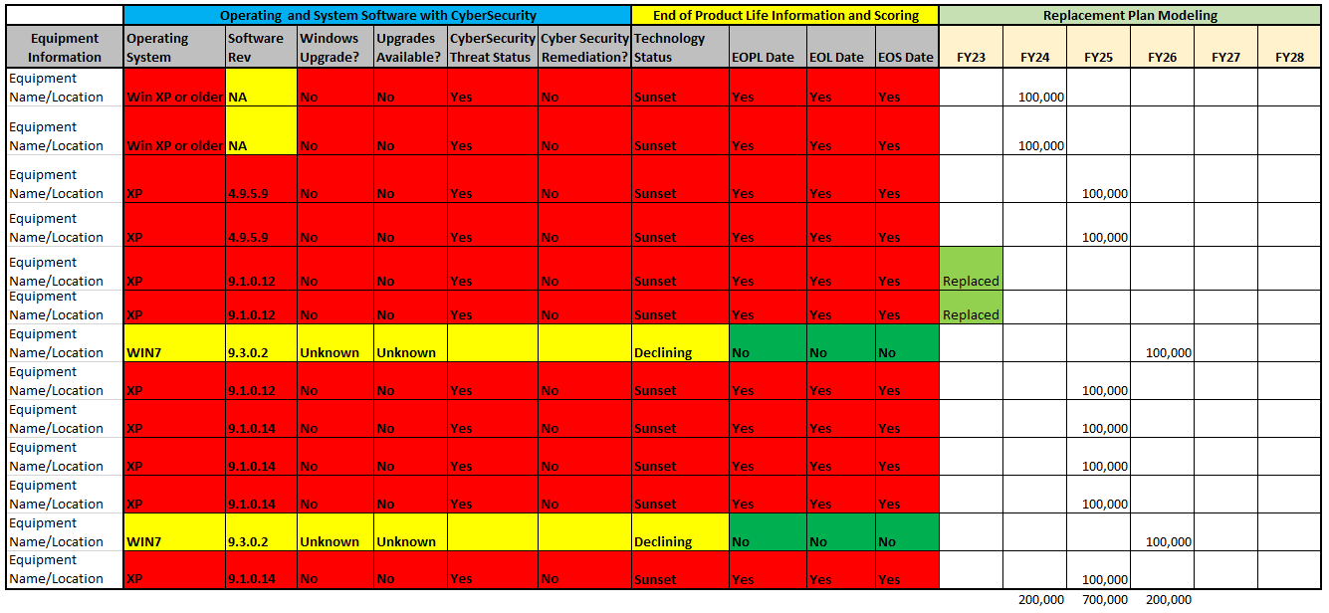
Implementing Replacement Roadmaps
Replacement Plan Modeling
Base replacement plan modeling by fiscal year on technology assessment. Adjust between budget years with finance partners.

Slide 9
Prioritization Criteria for Replacement
Holistic Approach to Replacement Planning
Clinical Input & Utilization
Financials & Risk
Department leader replacement ranking
Supplement with utilization data to sequence or narrow replacement priorities for large fleets
Verify stated benefits of new technology for improved features and efficiencies
Clinical Input& Utilization
Weigh service and replacement deferral options with safety and risk
Weigh against competing priorities for investments
Consider alternative options to extend value of existing equipment and costs/benefits of investment types
Financials & Risk
Service & Support
Service & Support
Condition & Safety
Validate 3rd party support options, in house support options
Assess availability of parts internally and in the market
Consider EOSL dates and compare service costs to replacement costs
Equipment Condition & Safety
Assess physical condition, downtime frequency and cost, remaining useful life
Assess safety recalls, cybersecurity and any patient safety events related to the device

Slide 10
How to Enrich your Imaging Technology Strategy
Engage health technology management (HTM) partners
Conduct a data validation of the current inventory management system
Identify opportunities to extend the equipment lifespan though upgrade paths with vendors
Establish replacement prioritization criteria
Present findings to the operating and finance leadership or capital committee structure for approval
Create a continuous review cycle for all modalities and work towards a 3–5-year replacement roadmap

Slide 11
Tips for Presenting Replacement Plans
Take a data driven approach that includes the why behind the what
Demonstrate that all alternatives to replacement have been considered
Spread replacements through a multi-year roadmap rather than requesting a proposing a significant increase in first year funding
Outline multiple scenarios for approval to give leaders a top recommendation, but multiple decision pathways
Consider the best funding approach for your organization and the equipment type (leases, rentals, capital purchases, placement agreements)

Slide 12
Questions?
Contacts:
Dean Skillicorn skillicd@slhs.org
Valerie Timm timmv@slhs.org

Slide 13

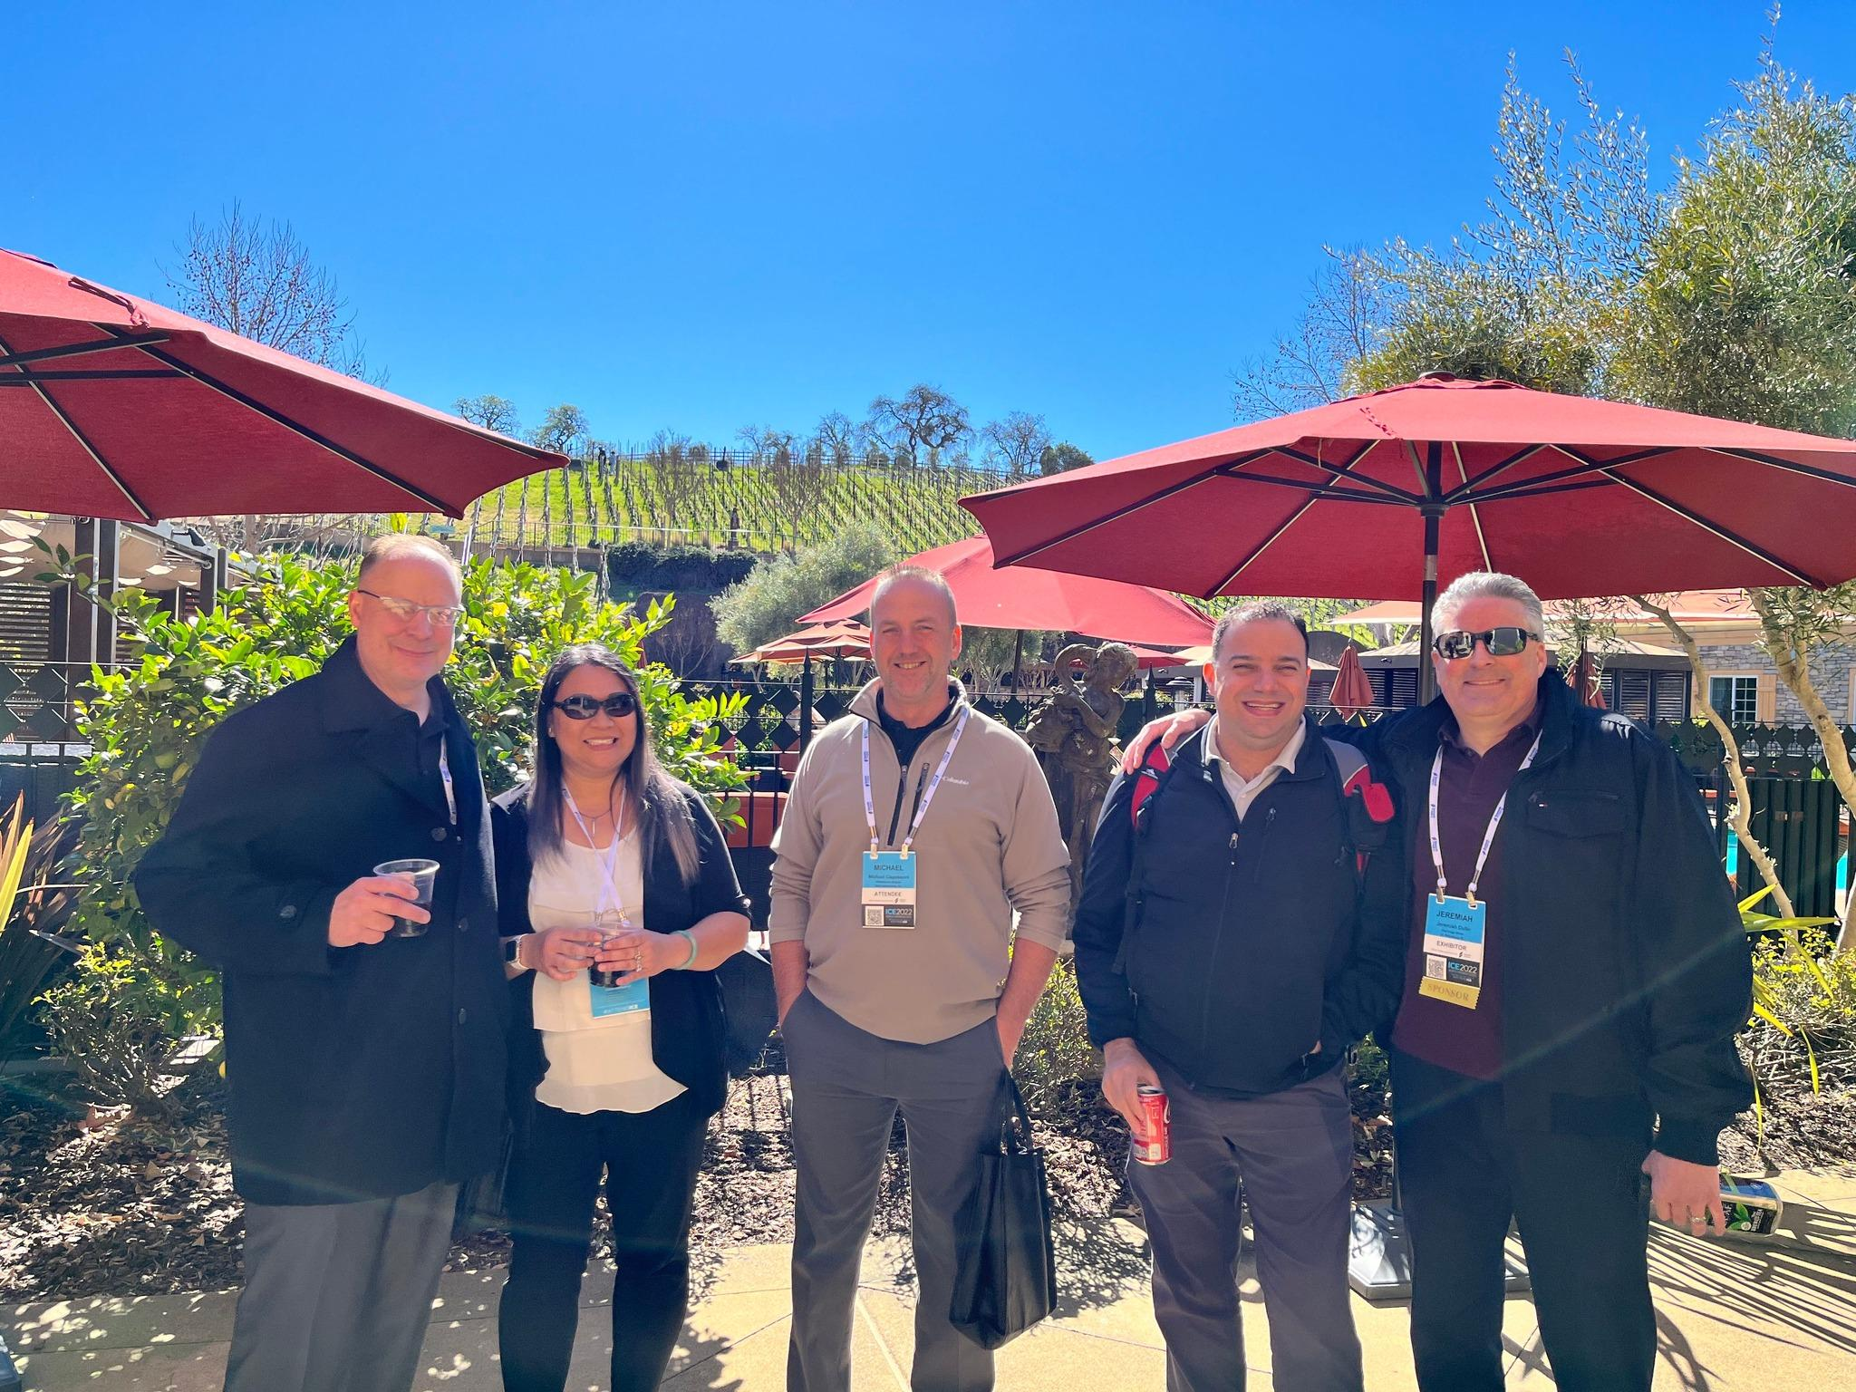

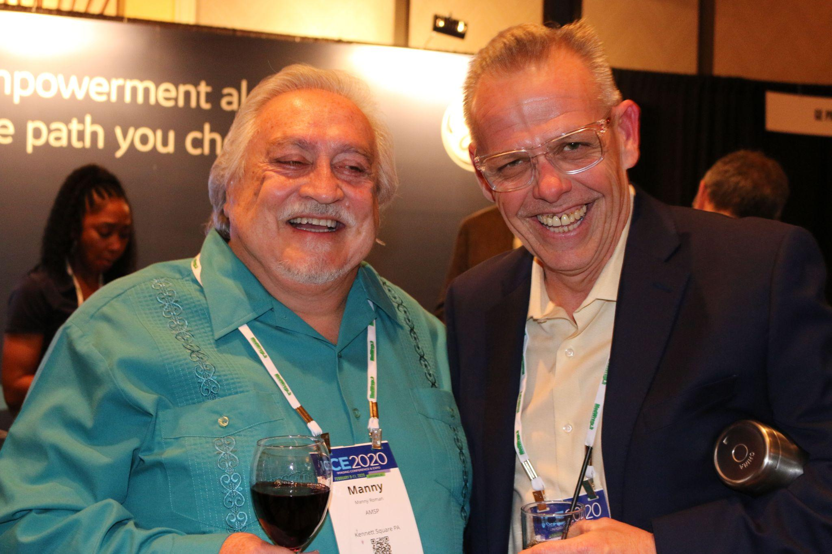
3 Easy Steps to Win $100!
Take a picture
Post on social media using #AttendICE
The attendee who uses the hashtag most throughout the conference will win a $100 gift card!!

