Slide 1
Standardization of Advanced Visualization to Improve CT Workflows
Jessica Chambers, MHA, RT(R)(CT)
Director of Clinical Operations-Imaging St Charles County

Slide 2
I have no financial interests or relationships to disclose regarding this presentation or conference.

Slide 3
Who am I?
Served in the United States Air Force as a Radiology Tech and CT Tech
21 years of experience
CT Supervisor
Imaging Manager
Imaging Director
Currently an Imaging Regional Director

Slide 4
Objectives
Financial challenges in CT departments across health care systems
Why Implement a 3D Advanced Visualization Lab
Challenges with Initial Justification of a 3D Advanced Visualization Lab
Benefits of Standardization
Growing a 3D Advanced Visualization Lab
Vision for the future at SSM Health
Notes:
Who was Impacted by this?
We luckily thought no worries we use Bracco products.
I told my locations hey stock up
Par levels – 90% allocations

Slide 5
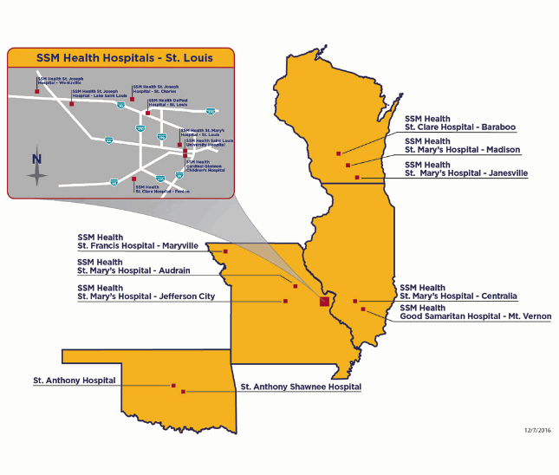
Who is SSM Health?

Slide 6
SSM St. Louis
SSM Health St Louis infrastructure
5 Adult Hospitals
1 Academic Adult Hospital
1 Children's Hospital
5 Freestanding Outpatient Imaging Centers
1 Joint Venture Freestanding Imaging Center

Slide 7
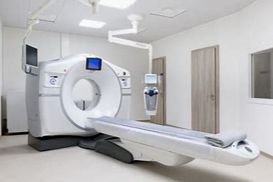
SSM St. Louis
CT Fleet of 22 Scanners
GE - 14
Philips - 5
Siemens - 3

Slide 8
Financial challenges in CT departments across health care systems

Slide 9
Financial challenges in CT departments across health care systems
Less Staff since Covid
Still very volume focus
Decrease Efficiency due to regulatory compliance
Unrealistic goals set

Slide 10
OUR Challenges
Challenges with our initial state
Three different contracted Radiologist groups
Variation of Scanners = Variation in Independent workstations
Software versions on the workstations were not updated
Lack of staff knowledge

Slide 11
Radiologists Concerns
Radiologist not satisfied with the variability in the advanced visualization images.
Radiologist requesting rework to be done by the “expert” delaying read time, sometimes next day.
Specific advanced visualization protocols designed for specific radiologists, variability in final product.

Slide 12
Equipment Concerns
Multiple vendor workstations in facilities
Technologist gravitate to the workstations they are comfortable with
Multi-vendor workstation produce inconsistent images
Budget constraints do not support purchasing software agreements.
Workstations were generations behind on software

Slide 13
Staffing Challenges
Variability in technologist post processing abilities
Decreased FTE’s impact department efficiency
Utilizing third party vendors for stent planning

Slide 14
Can a 3D lab Solve these Challenges?
Cost Savings and Improve efficiency
Improve Radiologist Satisfaction
Improve Employee Satisfaction
Improve Image Quality

Slide 15
Cost Savings
Stent Planning: Spending $72,600 per year on 3rd party stent planning plus extended turnaround times
Potential cost savings with transitioning to a single thin client reducing the need for upgrades etc.
Ability to transition to 20 min time slots
Increasing the potential for 8 additional appointment slots per facility

Slide 16
Consistency
Consistent Image quality by specialized technologist
Relationship building with Radiologists
Less rework requests by radiologist
Decreased stress/frustration for CT technologist
Frees up CT technologists to continue scanning
Standardized image quality by transitioning to a thin client

Slide 17
The Initial Vision
Dedicated 3D Tech to ensure quality and consistency of all exams
Started with the CT Cardiac Program due to the complexity of these exams
Start with 1 facility and continue to grow

Slide 18
Physician Expectations
All Abdominal/Pelvic CTs for ED patients are ordered STAT
STAT cases are priority in PACS
Radiologists dictate using Powerscribe, voice recognition system
Radiologists are required to self-edit all ED reports
Final Report sent to Electronic Record
Expectation for Radiologists to complete w/in 20 minutes

Slide 19
Justification Barriers to overcome
Initial capitol purchase for the Philips IntelliSpace portal or similar thin client solution
Replaces the multiple independent workstation purchases/upgrades
FTE request for a non-revenue generating position
Physical Space for the 3D lab
Gaining Physician/Radiologist trust to discontinue third party vendors

Slide 20
Additional Barriers learned
Who “owns” the 3D solution CES or IT
6 Servers live in the IHT building
Most “issues” related to the servers needing to be rebooted
Scanners all need to have VPN to servers - IT wanted CES to “own this”
SSM Health initially placed this in the hands of our CES team in 2021 this transitioned to IT

Slide 21
2012 The Beginning of our 3D Lab
1 Technologist working Day Shift Only
Averages 110 exams per month
Only performing 9 different studies
CTP
CTA Head/Neck
Run Offs
AAA
Dissections
Cardiac CTA
Urograms
Facial Reconstruction
MSK

Slide 22
The Actual Process
3D Lab physically located at SSM Heath St. Joseph Hospital
CT technologist places the study in a 3D lab “folder” in PACS
CT Tech ends exam in EHR
Upon completion of the post processing 3D lab technologist verifies exam for Radiologists read
3D lab tech bookmarks exam allowing Radiologist the ability to adjust if needed

Slide 23
2013 We Need Another Tech!
2 Technologist working staggered day shift (0630-1700)
Averaging 390 exams per month
Added applications
Stent Planning (after 6 months validation process)
Virtual Colon
TAVR
MR Applications
PET
Nuclear Medicine
Ablations

Slide 24
Continued Growth
2012 | 2013 | 2014 | 2015 | 2016 | 2017
1,320 Exams Per Year | 4,784 Exams Per Year | 7,668 Exams Per Year | 9,372 Exams Per Year | 12,456 Exams Per Year | 12,981 Exams per year

Slide 25
2017 We need a 3rd tech!
Tracked exams left at the end of the day
Averaged 7 exams held over each day
Purchased additional applications to grow volume
Physician Support – 3D lab are the Radiologists trainers

Slide 26
Added Applications for the Lab
Cardiology
Neurology
Oncology
Multi Modality Viewer (MMV)
Vascular
MR Smart Display Protocols
(in MMV)
iXR Viewing
(in MMV)
XA Vascular Processing – DSA (in MMV)
Multi Modality Viewer (MMV)
Multi Modality Viewer (MMV)
CT Comprehensive Cardiac Analysis (CCA)
CT Cardiac Viewing
XA Vascular Processing – DSA (in MMV)
US Viewing
(in MMV)
CT Lung Nodule Assessment (CAD)⁽⁵⁾
Multi Modality Viewer (MMV)
XA Vascular Processing – DSA (in MMV)
Multi Modality Advanced Vessel Analysis (AVA) Stenosis
XA Vascular Processing – DSA (in MMV)
CT Cardiac Plaque Assessment
CT-MI
Fusion
CT Virtual Colonoscopy
Multi Modality Tumor Tracking (MMTT)
MR MobiView
iXR Viewing
(in MMV)
US Viewing
(in MMV)
MR Perfusion Diffusion Mismatch
CT Brain Perfusion
MR Subtraction
CT Calcium Scoring
CT TAVI
Planning
CT EP
Planning
CT Body Perfusion
Multi Modality Advanced Vessel Analysis (AVA)
US Q-App Microvascular Imaging (MVI)
MR T2*
(Neuro) Perfusion
MR MobiView
CT Myocardial Defect Assessment
CT Dynamic Myocardial Perfusion (DMP)
Multi Modality Tumor qEASL (MMTT qEASL)⁽⁹⁾
CT Cardiac Viewer
CT Liver
Analysis
CT Lung
Nodule Assessment (LNA)
MR T1 Perfusion
CT Acute MultiFunctional and (AMFR) Review
US Q-App Intima Media Thickness (IMT)
NM EQuAL⁽⁶⁾
MR Permeability
MR IViewBOLD
MR Cardiac Temporal Enhancement
MR Cardiac Functional Analysis
MR Cardiac Viewing
MR Spatial Enhancement
MR Cardiac Whole Heart
CT Body Perfusion
MR Permeability
US Q-App General Imaging 3D Quantification (GI 3DQ)
US Q-App Vascular Plaque Quantification (VPQ)
MR Diffusion
MR FiberTrak
NM Astonish Reconstruction
MR Cardiac Analysis
MR QFlow
US Q-App Region of Interest
(ROI)
NM Review
NM NeuroQ 3.7⁽⁶⁾
MR SpectroView
MR QFlow
Cedar-Sinai Cardiac Suite 2015⁽¹⁾
Corridor4DM⁽³⁾ 2015
US Q-App General Imaging 3D Quantification (GI 3DQ)
MR SpectroView
NM NeuroQ Amyloid⁽⁶⁾
US Q-App General Imaging 3D Quantification (GI 3DQ)
Emory Cardiac Toolbox 4.1⁽²⁾
MR Cardiac Quantitative Mapping
Multi Modality Viewer (MMV)
US Q-App Microvascular Imaging (MVI)
Collaboration Viewer⁽⁷⁾
XA Vascular Processing – DSA (in MMV)
Orthopedics
CT
US
NM
MR
Multi-modality
Enhanced
New
CT COPD
DXR Viewing
(in MMV)
MR Cartilage Assessment
CT Bone Mineral Analysis (BMA)
CT Dental Planning
MR Echo Accumulation
CT Acute MultiFunctional Review (AMFR)
CT Bone Mineral Analysis (BMA)
CT Cardiac Viewer
NM Review
MR Cartilage Assessment
CT Pulmonary Artery Analysis⁽³⁾ (PAA)
NM JETPack Application Suite
US Viewing
(in MMV)
US Q-App Elastography Analysis (EQ)⁽⁸⁾
NM Processing Application Suite
MR Echo Accumulation
CT Acute MultiFunctional Review (AMFR)

Slide 27
2018 3rd Tech Starts
2018 Added a 3rd technologist to work evening hours
Designating roles to the lab staff around process Improvement
1 Technologist is a Radiologist Liaison
1 Technologist is a Scan Protocol Liaison
1 Technologist Physicians Organization and Applications Liaison

Slide 28
Continue to Grow Volumes of the Lab
2019 | 2020 | 2021 | 2022
13,480 Exams Per Year | 10,471 Exams Per Year * OP centers closed during Covid | 13,901 Exams Per Year | 14,032 Exams Per Year

Slide 29
Still Room For Improvement
Consistency in care - 3D lab does not work weekends
3D lab does not cover nights
Elimination of Double Processing as the 3D lab reworks the night techs post processing each morning.

Slide 30
The Lab Helps Solve Problems
Supports Radiologists/Cardiologist training
Portal Super Users
CAD Super Users
Developed a process for utilizing the portal as an image storage solution for TAVR and Super D
Back up for PACS downtime
Utilized as an image viewer for afterhours specialists

Slide 31
Not Done Yet!!!
Opportunities to expand the 3D Lab
24 Hours support (In Process)
Continue to add free standing Imaging Centers
Supporting out of state SSM facilities

Slide 32
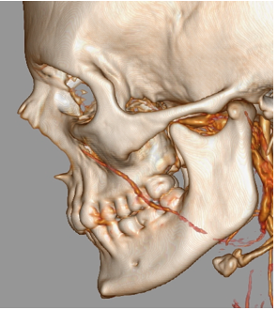
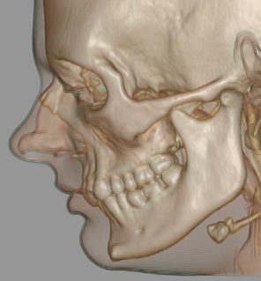
Sample Images

Slide 33
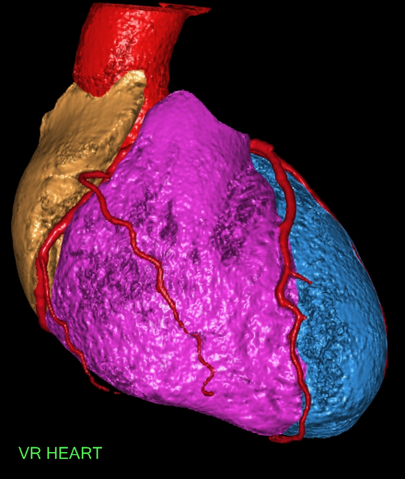
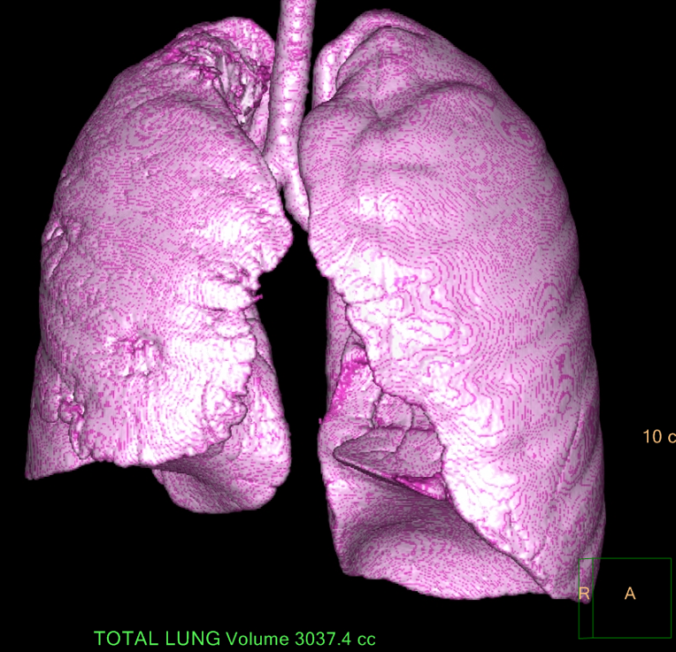
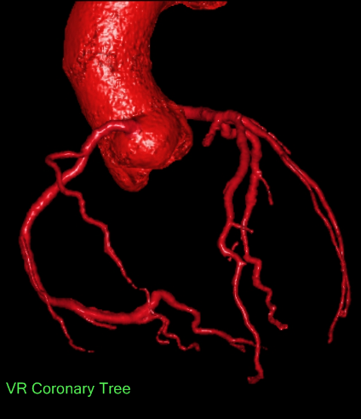
Sample Images

Slide 34
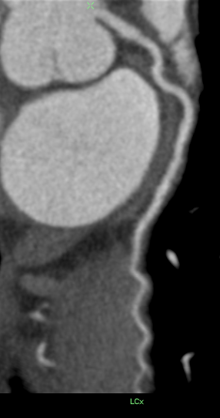
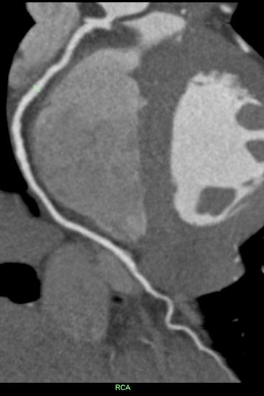
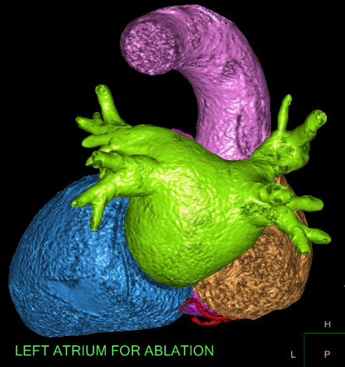
Sample Images

Slide 35
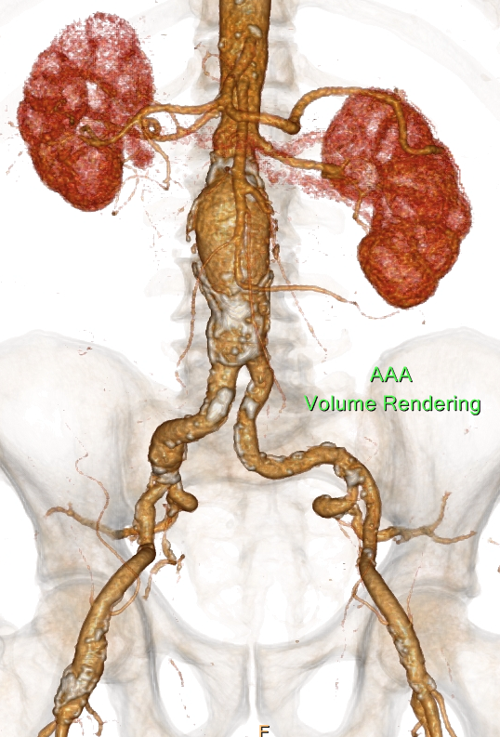
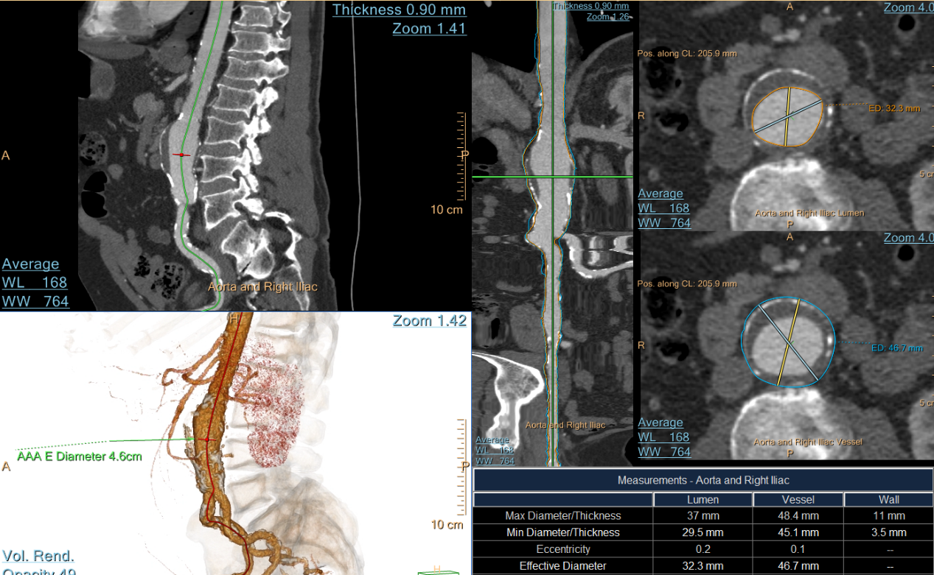
Sample Images

Slide 36
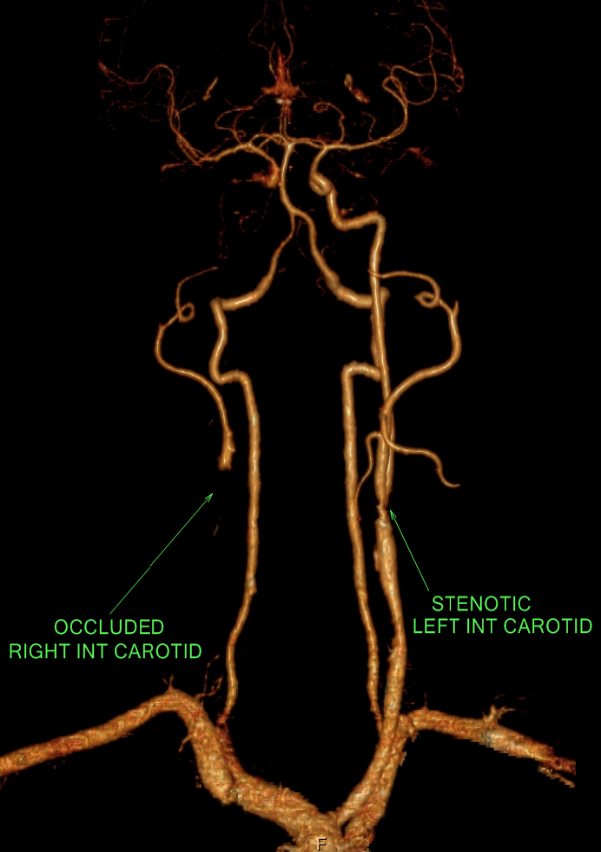
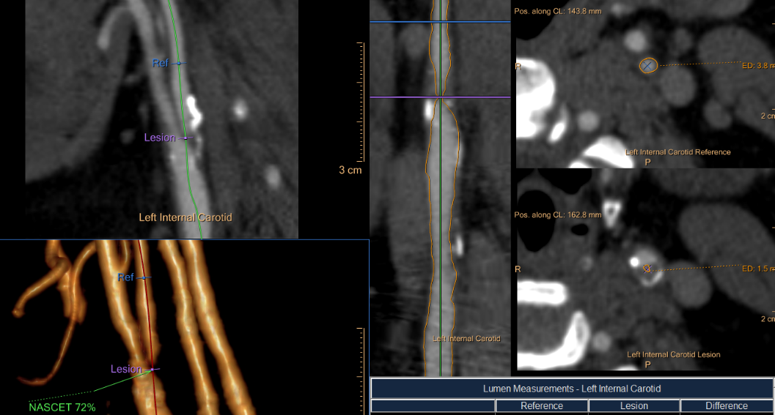
Sample Images

Slide 37
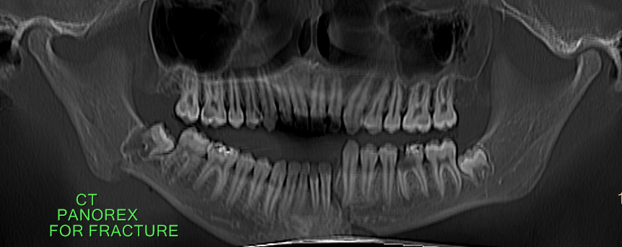
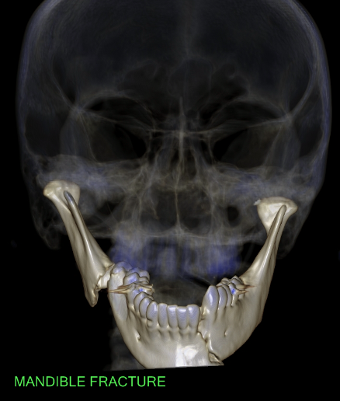
Sample Images

Slide 38
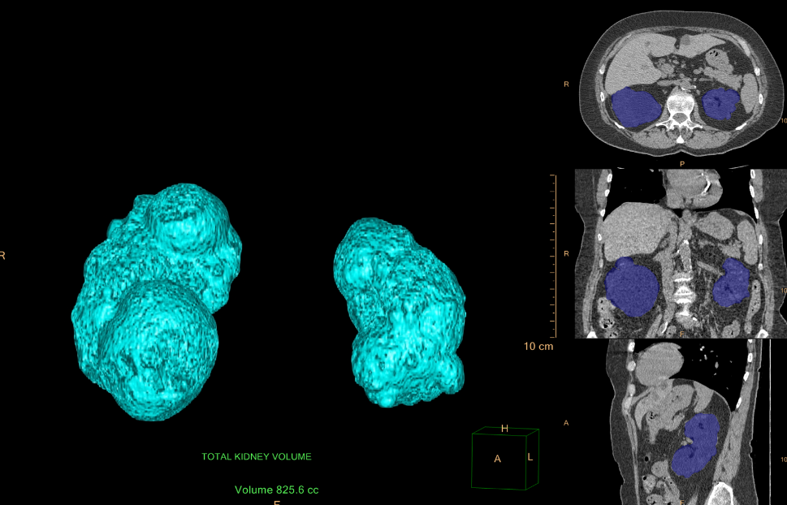
Sample Images

Slide 39
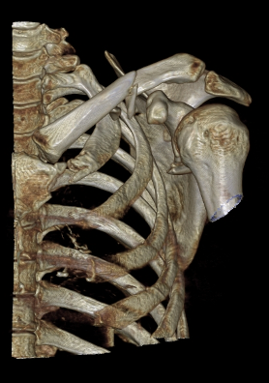
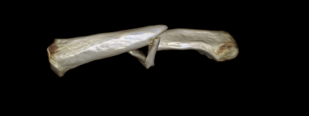
Sample Images

Slide 40
Contact information
Jessica Chambers, MHA, R.T.(R) (CT)
Director of Clinical Operations- Imaging Services
St Charles County
Jessica.chambers@ssmhealth.com
(636)695-2350

