Slide 1
Preparing for a Cyber-Attack
in Imaging
Angelic P. Bush, MSRS, CRA, RT(R)(CT)(MR), FAHRA
University of Texas Medical Branch, System Director Radiology

Slide 2
Why is healthcare one of the biggest targets for cyber-attacks
Private patient information is worth a lot of money to attackers
Medical devices are an easy entry point for attackers
Staff need to access data remotely, opening up more opportunities for attack
Workers don’t want to disrupt convenient working practices with the introduction of new technology
Notes:
2. Medical devices are an easy entry point for attackers
There aren’t many downsides to innovations in healthcare technology these days. Medical devices like x-rays, insulin pumps and defibrillators play a critical role in modern healthcare. But for those in charge of online security and patient data protection, these new devices open up more entry points for attacks. Medical devices fulfill specific purposes – like monitoring heart rates or dispensing drugs. Security is not a primary concern in design. Although the devices themselves may not store patient data, attackers can leverage devices to launch an attack on a server that does hold valuable information. In a worst-case scenario, hackers can completely take over a medical device, preventing healthcare organizations from providing necessary life-saving treatment to patients.
Hackers know that medical devices don’t contain any patient data themselves. However, they see them as an easy target, lacking the security found on other network devices like laptops and computers. Threats against medical devices can cause problems for healthcare organizations – giving hackers access to other network devices or letting them install costly ransomware. Secure network devices help limit the damage caused by an attack on medical devices.
3. Staff need to access data remotely, opening up more opportunities for attack
Collaborative working is vital in the healthcare industry, with units working together to provide the best solution for every patient. Those who need to access information aren’t always sitting at their desk – they are often working remotely from different devices.
Connecting to a network remotely from new devices is risky, as not all devices will be secure. Additionally, healthcare staff are often unfamiliar with even the most basic cybersecurity best practices. Compromised devices must never gain access to the network, as just one hacked device can leave a whole organization wide open. One option for organizations with staff working across devices is risk-based authentication (RBA). This solution makes risk analysis simpler by letting IT staff set up policies that determine the risk of a given device based on factors like the user, their location and more. Any unusual activity is then flagged to ensure that unsafe devices cannot access sensitive patient data.
4. Workers don’t want to disrupt convenient working practices with the introduction of new technology
Healthcare staff are some of the busiest and most in-demand in the country. Staff work long hours and to tight deadlines – which means they don’t have the time or resources to add online security processes to their workload. Medical professionals need slick working practices with minimal distractions.
Healthcare organizations need to assess the impact of any cybersecurity measures they want to implement. IT staff should try to align security measures with existing software. Many authentication solutions work seamlessly with software like Office 365, meaning medical staff can perform their daily tasks without distraction.
Using Single Sign-On (SSO) solutions means authorized users can access multiple applications using just one set of login information – keeping their working routines quick and straightforward without compromising security. Frictionless solutions like SSO and RBA offer adequate protection against online threats without disrupting how people work.

Slide 3
Why is healthcare one of the biggest targets for cyber-attacks
Healthcare staff aren’t educated on online risks
The number of devices used in hospitals makes it hard to stay on top of security
Healthcare information needs to be open and shareable
Outdated technology means the healthcare industry is unprepared for attacks
Notes:
5. Healthcare staff aren’t educated on online risks
Medical professionals do not have the necessary expertise to recognize and mitigate online threats. Budget, resources, and time constraints mean it’s simply impossible for all healthcare staff to be fluent in cybersecurity best practices.
Cybersecurity solutions are complex, but their interface needs to be simple. Medical staff requires a secure network that is quick and easy to access. And they need the peace of mind of knowing that patient data are protected. Solutions like MFA and SSO are becoming more popular as they use a secure one-time code – adding extra layers of security that don’t require the user to know anything more than their login credentials.
6. The number of devices used in hospitals makes it hard to stay on top of security
Modern healthcare organizations are responsible for massive amounts of patient data, plus an extensive network of connected medical devices. Larger organizations can deal with thousands of medical devices connected to their network, each acting as a potential threat for attackers.
Healthcare staff are often too busy to stay educated on the latest threats to devices, leaving IT specialists with the task of protecting an entire hardware network against attacks. If just one device becomes compromised, it opens the whole network up to data breaches and medical device hacks.
There is a need for healthcare professionals to be able to manage their own devices to an extent – freeing up IT specialists to deal with broader IT and security issues within the network. Some MFA solutions offer a self-service portal, which allows users to reset security PINs and more by themselves, helping to lighten the workload on the support desk.
7. Healthcare information needs to be open and shareable
Confidential patient data needs to be accessible to staff, on-site and remotely, and on multiple devices. The typically urgent nature of the medical industry means a team needs to be able to share information immediately. There’s no time to pause and consider the security implications of their devices.
The worry for IT staff is that the devices used to share information are not always protected. They can’t always be there to assess the credentials of every device, especially in a time-critical environment. Users accessing data remotely will only need privileges for their tasks to perform. So, if they’re checking their emails, they won’t need to have full admin account privileges—precautions like this limit the chance of admin accounts becoming compromised.
Any solution that can save time and money by automatically regulating user permissions without putting patient data at risk is a must-have for healthcare companies. MFA solutions prevent attacks from compromised credentials or unauthorized users to ensure only the right people can access sensitive data.

Slide 4
COVID increased cyber-attack risks
Stealing intellectual property such as data relating to COVID-19 vaccine development, modelling and experimental therapeutics.
A cyberattack that halted the network of a Czech hospital in March,
A ransomware attack on a vaccine trial group in UK in March
An unspecified cyber-attack on the US Health Agency in March
An unspecified cyber-attack on the construction company building the UK’s emergency COVID-19 hospitals in May
An alleged state-sponsored attack on UK, US and Canadian universities developing a COVID-19 vaccine in July

Slide 5
Ransomware Risk Categories
Medical Malpractice – EMR is not accessible, thus increasing risk of medication errors
Data Privacy – potentially violate Health Insurance Portability & Accountability (HIPPA) Act
Property & reputation – Can impact future business negotiations and partnerships
Cost & expense – paying cybercriminals & continued monitoring of patient information and credit monitoring

Slide 6
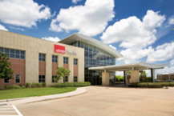
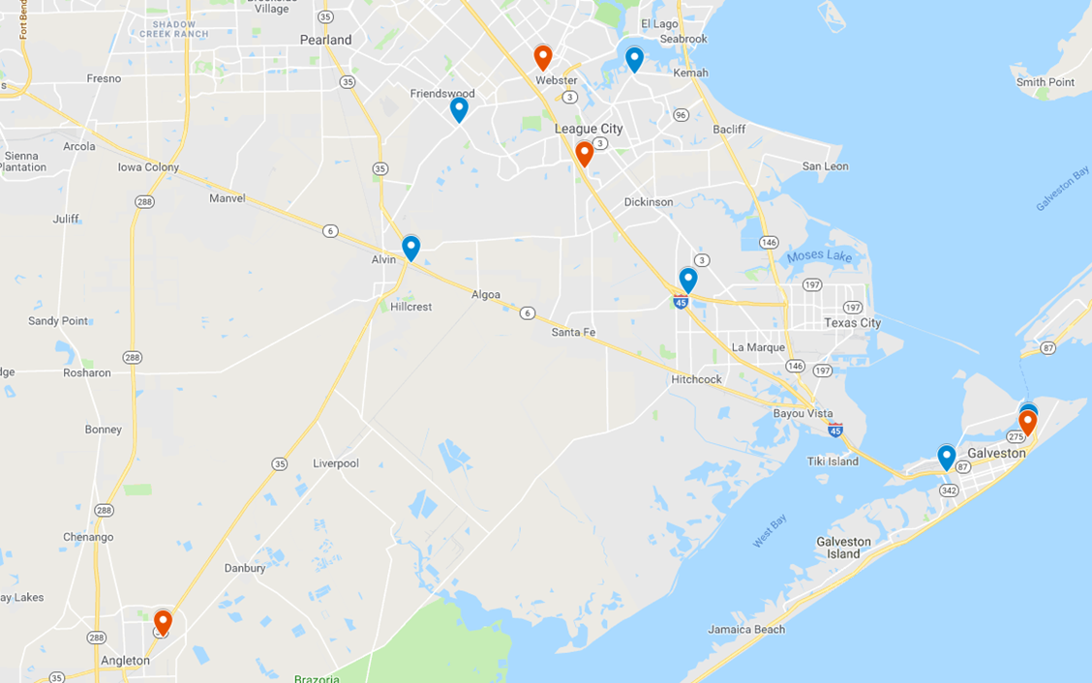
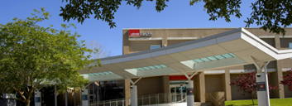

Slide 7
Background
25 Staffed faculty & 4 PBL Faculty
31 residents & 3 Fellows
228 imaging staff members across 5 campuses
Performed 397+K exams annually
Radiology group interprets 433+K exams annually

Slide 8
HOW to prepare?
Engaging Key Stake Holders
Front Line Staff
Radiologists
IT
Biomed
Management Team
Nurse Managers?
ER faculty?
ICU and/or unit faculty?
Revenue Cycle
These stakeholders ensure true operations

Slide 9
Identify differences between a traditional downtime and a CYBERATTACK downtime!
Length of time expected to be down
MERGE process once back up
Billing process during downtime
Archival during downtime
Interpretation challenges
Hours to MONTHS!
Reconciliation of images & reports
No billing for months?
Film library
Specialty readers in each reading room

Slide 10
Preparation - Equipment & Risk
Biomed/IT - Inventory of all modalities.
What software is EACH piece of equipment on?
Which equipment is on software levels more at risk? (i.e. 2017 Microsoft)
What do they connect to? (Post processing workstations etc.)
What kind of connection are these?
Push from modalities? Push from PACS? A PULL system?
How can we download the images if not through a network (CD, USB, DVD)
VALIDATE!!! VALIDATE!!! VALIDATE!!!
Now we know the status of our equipment resources

Slide 11
Preparation – Reading Rooms
Multi-Disciplinary Reading Rooms
Each campus needs a multidisciplinary reading room.
Radiologist will be reassigned to provide on site coverage 24/7
Assign staff member to work as reading room assistant and image archiver

Slide 12
Preparation - Equipment
Clear modality ques
This will allow us to “store” as many cases as possible on the consoles

Slide 13
Preparation – Command Center
Imaging Command Center
Single phone line per campus
Central location responsible for ingesting all imaging requests
We would send a staff member to the floors to “pick up” requests, bring them down and distribute to modalities
Will also act as Imaging library organizing the imaging CDs or flash drives with copies of the reports.

Slide 14
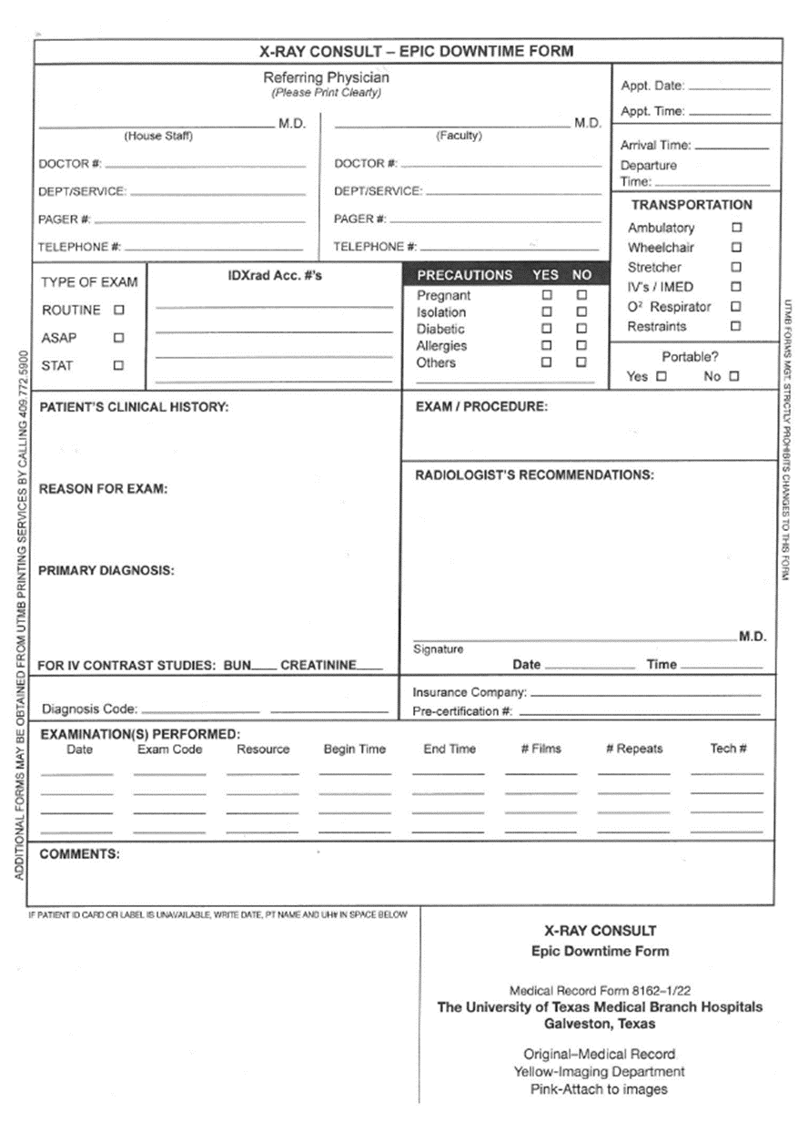
Workflow – The Request
Dept of Radiology has on had boxes of X-ray Consult forms and will immediately distribute them to all units and ER.
Requests for IP/ER imaging will be entered on these documents.

Slide 15
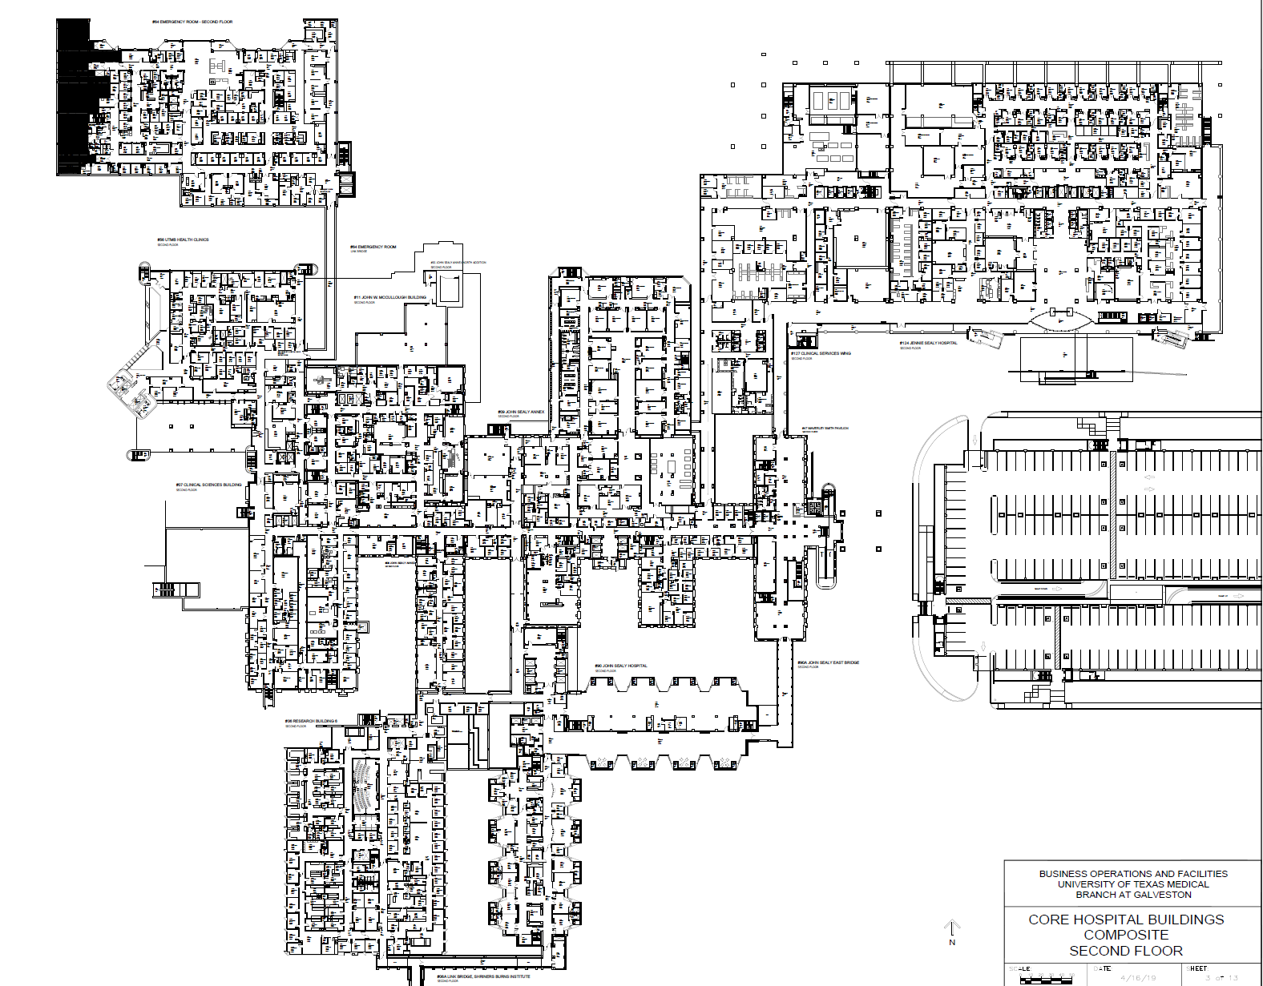

Slide 16
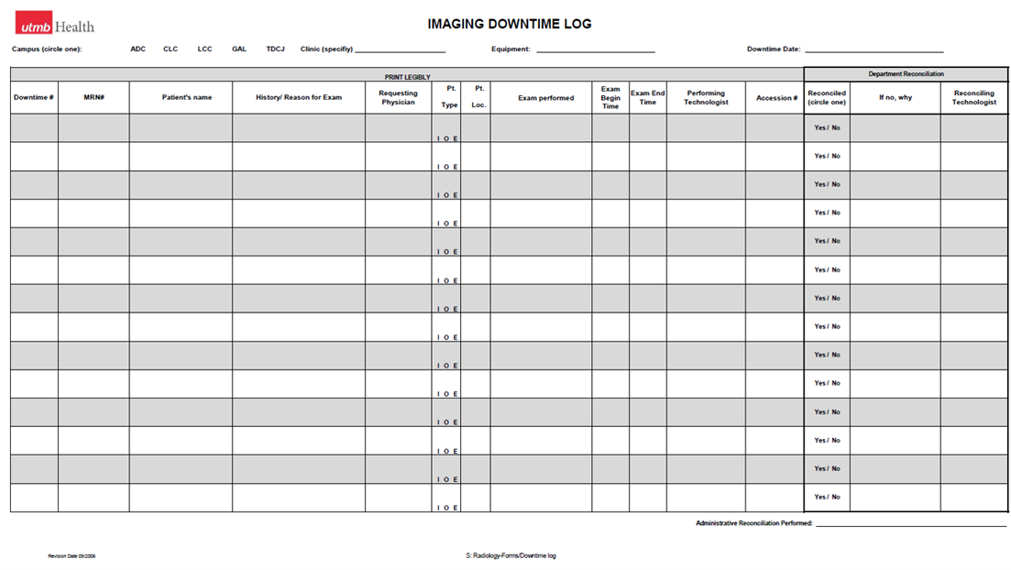
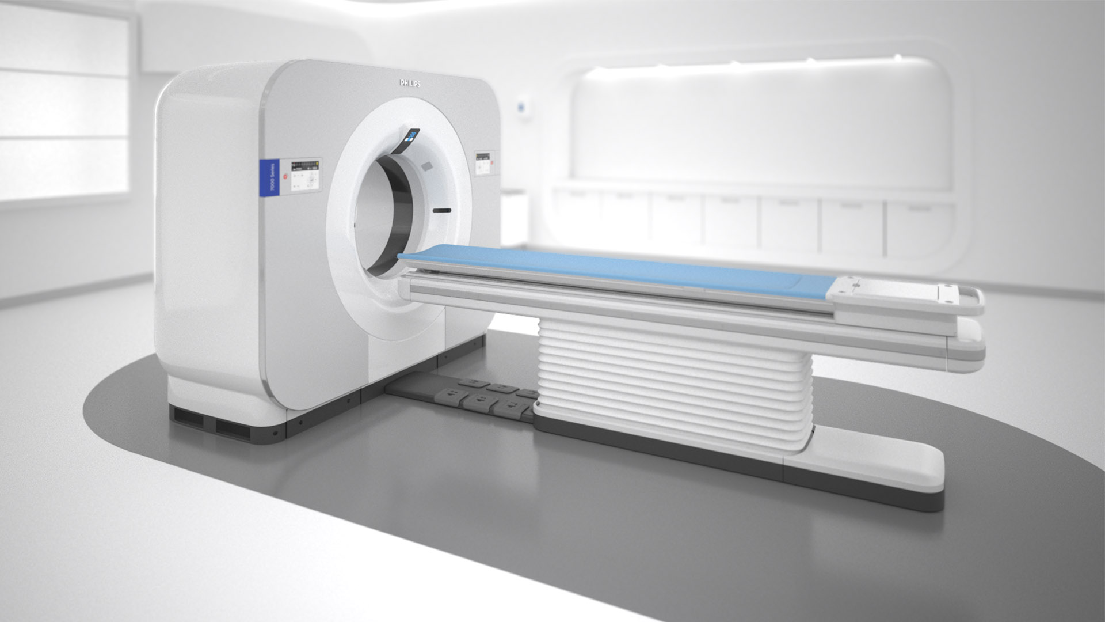
Notes:
Technologist completion of X-ray consult form
The technologist should utilize IMAGING DEPARTMENT CYBER-ATTACK CODE GUIDE to complete the “examination(s) performed” section of the downtime form. This should include the CPT codes for the exam performed by the technologist.
The technologist should utilize the “comments” section to write any pertinent notes to the radiologist.

Slide 17
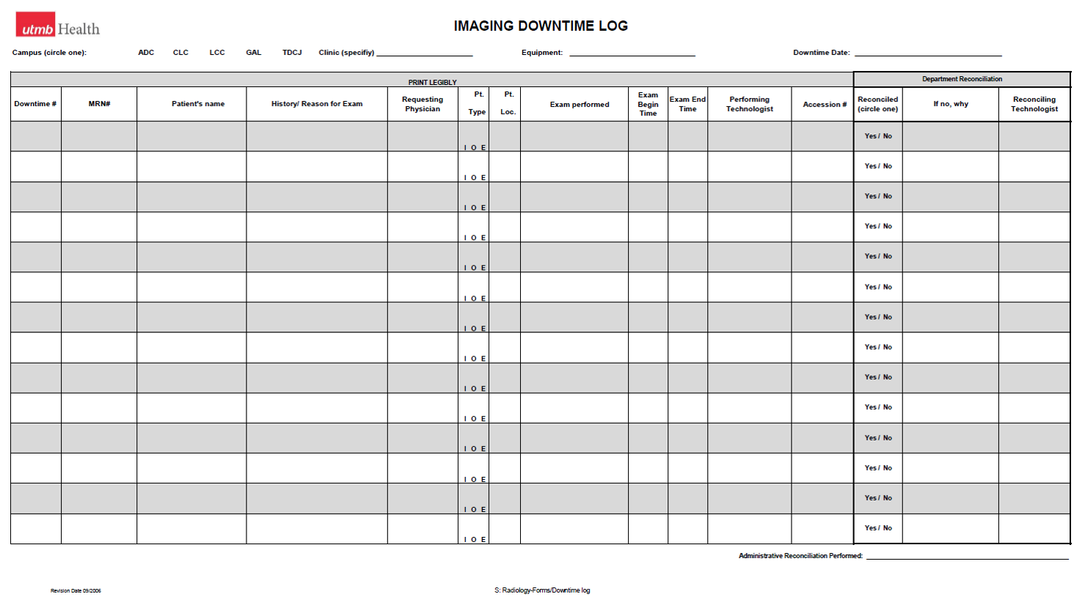

Slide 18
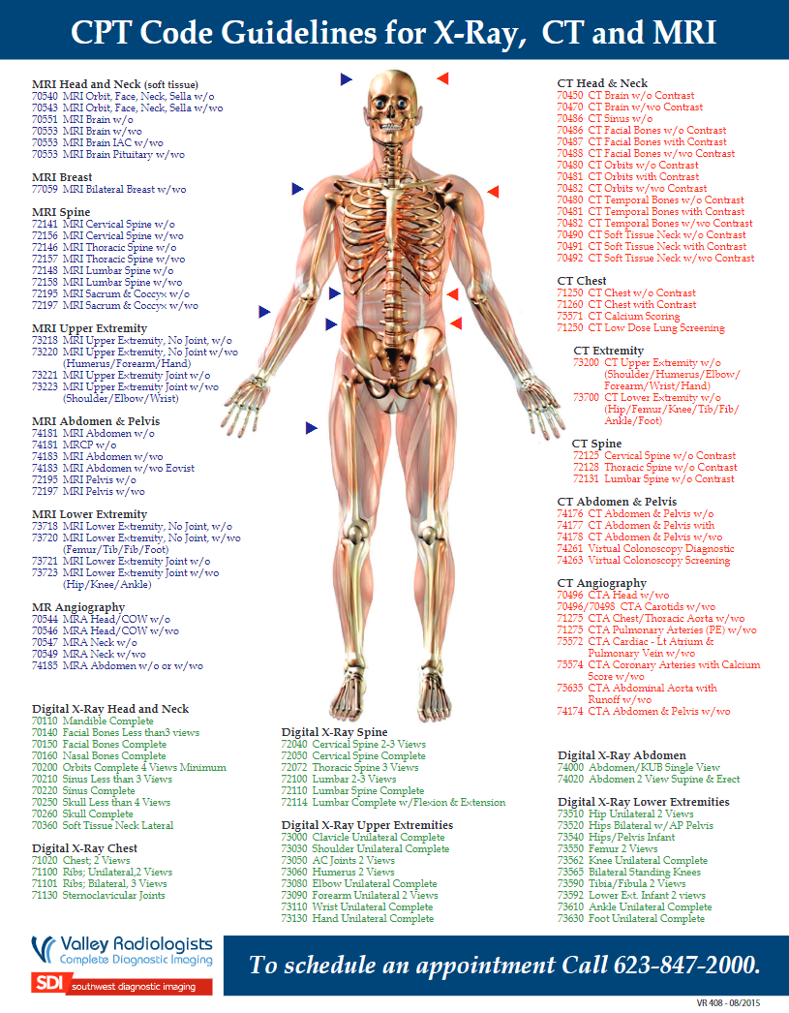
Imaging Department Cyber-Attack Code Guide
A list of all CPT codes by modality
Printed, laminated and available on each and every imaging modality
The most common CPTs can be highlighted
Or… you can find these on the web
Notes:
Technologist completion of X-ray consult form
The technologist should utilize IMAGING DEPARTMENT CYBER-ATTACK CODE GUIDE to complete the “examination(s) performed” section of the downtime form. This should include the CPT codes for the exam performed by the technologist.
The technologist should utilize the “comments” section to write any pertinent notes to the radiologist.

Slide 19
Notes:
Technologist completion of X-ray consult form
The technologist should utilize IMAGING DEPARTMENT CYBER-ATTACK CODE GUIDE to complete the “examination(s) performed” section of the downtime form. This should include the CPT codes for the exam performed by the technologist.
The technologist should utilize the “comments” section to write any pertinent notes to the radiologist.

Slide 20
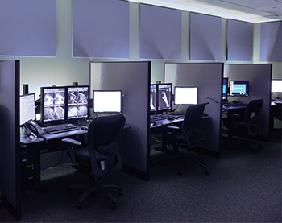
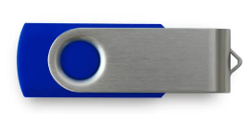
Interpretation
ANYTHING!
Multi-Disciplinary Reading Rooms
Chest/Body
Neuro
MSK
Pedi

Slide 21
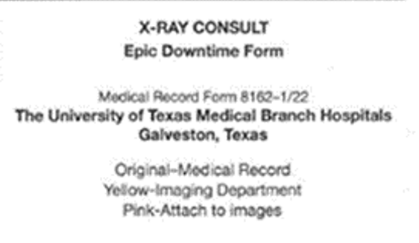
Archival – Reading Room Assistants/Film Library
Top copy goes with the patient to be part of their chart.

Slide 22
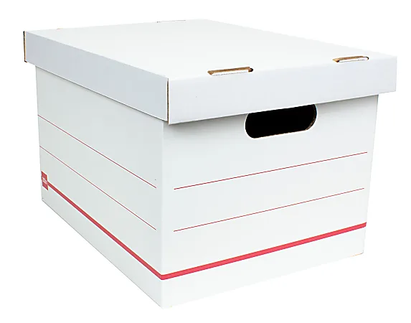
Archival of Images/Report
Archival of images/report
The pink copy of the downtime form is to be placed with the storage device (CD, DVD or USB) in a sealed manilla folder with the patient’s identification information (name, MRN or downtime number, exam and date/time) on the outside of the folder.
These will be placed in boxes and stored until loading into PACS is available.

Slide 23
Preparation - Image Archival
We know which equipment can archive via CD, via USB, or via DVD
How much will we have to archive?
This brings an operational question. Will we keep doing Out-Patients?
How many CDs, USBs, or DVDs will we need per month of downtime?
Order 1 month worth and put process in place for a quick order for additional months at a time.

Slide 24
Summary
Identify Key Stakeholders
Appreciate differences between a routine downtime and a cyberattack
Identify risky equipment
Outline basic requirements for operation: request, exam performance, interpretation, archival, billing.
Think BIG! and longer terms.
Discuss the flow: requisition, communication, archival, reconciliation
Act! Have supplies on hand immediately and easily restocked
Fully disclose pain points

Slide 25
3 Easy Steps to Win $100!
Take a picture
Post on social media using #AttendICE
The attendee who uses the hashtag most throughout the conference will win a $100 gift card!!

Slide 26
Muthuppalaniappan M, Stevenson K. Healthcare cyber-attacks and the COVID-19 pandemic: an urgent threat to global health. Int J Qual Health Care. 2021 Feb 20;33(1):mzaa117. doi: 10.1093/intqhc/mzaa117. PMID: 33351134; PMCID: PMC7543534.
Kapoor A, Vora A, Yadav R. Cardiac devices and cyber attacks: How far are they real? How to overcome? Indian Heart J. 2019 Nov-Dec;71(6):427-430. doi: 10.1016/j.ihj.2020.02.001. PMID: 32248912; PMCID: PMC7136318.
Kruse, Clemens Scott et al. ‘Cybersecurity in Healthcare: A Systematic Review of Modern Threats and Trends’. 1 Jan. 2017 : 1 – 10.

