Slide 1
The Connection Between Well-Being, Staff Turnover and a High Reliability Organization
John J. Beall, MAA-HA, FAHRA
Health System Specialist – Strategic Planner
VA Puget Sound Health Care System
Notes:
Thanks My Why

Slide 2
Objectives
What does well-being mean, and how does it affect you and your staff?
How does being an active High Reliability Organization (HRO) contributes to improving turnover?
How can communication and teamwork help give your staff ownership and the desire to stay

Slide 3
What is Well-Being?

Slide 4
What is Well Being?
Employee wellbeing is defined as the overall mental, physical, emotional, and economic health of your employees. It is Influenced by various factors:
Relationships with co-workers, decisions they make, and the tools and resources they have access to
Hours, pay, and workplace safety also have a significant impact on employee wellbeing
https://www.wrike.com/blog/what-is-employee-wellbeing-why-does-it-matter/

Slide 5
What is Well Being?
While it will vary from person to person, employee wellbeing should average out to a level that allows for a productive and healthy workplace
Outside factors contribute to employee wellbeing too:
Stress around issues such as housing, health, and family all play a role in performance at work
https://www.wrike.com/blog/what-is-employee-wellbeing-why-does-it-matter/

Slide 6
Employee Well-Being
Notes:
How many of your organization have a form of employee well being programs
VA → Veteran Well-Being & Staff Well-Being programs

Slide 7
Employee Well-Being
According to a recent employee wellbeing study by Alight, less than half of U.S. employees have a positive perception of their overall wellbeing
Overall, there has been a major decline in employee wellbeing from early 2020 to mid-2021, even as employees return to work at the office again
https://www.wrike.com/blog/what-is-employee-wellbeing-why-does-it-matter/
https://www.alight.com/thought-leadership/2021-employee-wellbeing-mindset-study

Slide 8
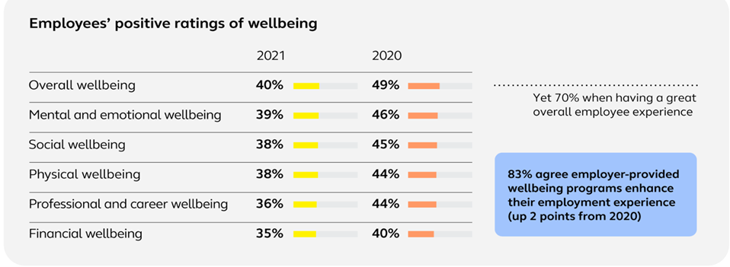
Employee Well-Being
Less than half of U.S. employees have a positive perception of their overall wellbeing as we saw a major decline from early 2020
https://www.wrike.com/blog/what-is-employee-wellbeing-why-does-it-matter/
https://www.alight.com/thought-leadership/2021-employee-wellbeing-mindset-study

Slide 9
Employee Well-Being
The pandemic has tested the mental resiliency of employees, but the good news is people see value in mental health support
4 in 10
43%
86%
workers say the pandemic has caused their emotional and mental wellbeing to decline
of employees or their dependents sought counseling – up from 28% in 2018
of managers say mental and emotional health training would be valuable in their role as a manager
https://www.wrike.com/blog/what-is-employee-wellbeing-why-does-it-matter/
https://www.alight.com/thought-leadership/2021-employee-wellbeing-mindset-study

Slide 10
Employee Well-Being
Employees are exploring ways to optimize health care and reduce costs
66%
82%
76%
are saving for health care expenses not paid by insurance - up 6 points from 2020
would use Telehealth again, even once the pandemic passes
would be comfortable sharing personal health information for personalized health and wellness guidance — up 4 points from 2020
https://www.wrike.com/blog/what-is-employee-wellbeing-why-does-it-matter/
https://www.alight.com/thought-leadership/2021-employee-wellbeing-mindset-study

Slide 11
Employee Well-Being
While many employees are burned out, parents and caregivers in particular struggle to juggle remote learning/caregiving support with their work
41%
55%
of workers are experiencing symptoms of burnout
of working parents believe that remote learning/caregiving support along with their current workload is too much to handle
https://www.wrike.com/blog/what-is-employee-wellbeing-why-does-it-matter/
https://www.alight.com/thought-leadership/2021-employee-wellbeing-mindset-study

Slide 12
Employee Well-Being
Employees are overwhelmed and need help finding the bandwidth and money to improve their well being
4 in 10
1 in 3
38%
85%
have or seriously considered, due to costs, avoided medical care for self or family member, reduced or stopped saving for the future, OR stopped, took less or delayed a prescription
employees are sometimes or often struggling to access healthy food and clean water, health services, safe housing, transportation or outdoor spaces
say living a truly healthy life requires more time, attention and/or money than they’re willing to spend — up 5 points from 2020
say “wellbeing programs offered by my employer make me feel better about my employer” — up 4 points from 2020
https://www.wrike.com/blog/what-is-employee-wellbeing-why-does-it-matter/
https://www.alight.com/thought-leadership/2021-employee-wellbeing-mindset-study

Slide 13
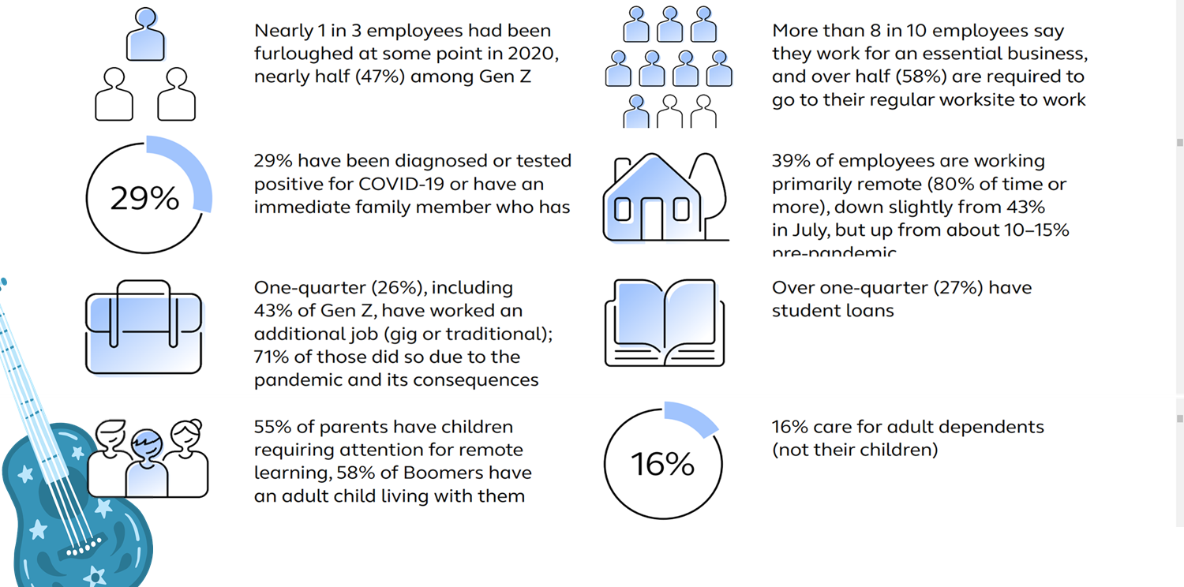
About the People Surveyed
https://www.wrike.com/blog/what-is-employee-wellbeing-why-does-it-matter/
https://www.alight.com/thought-leadership/2021-employee-wellbeing-mindset-study

Slide 14
Let’s Talk About Burnout

Slide 15
Understanding Burnout
“a prolonged response to persistent work-related stressors and includes elements of exhaustion, depersonalization, and perceived ineffectiveness.”

Slide 16
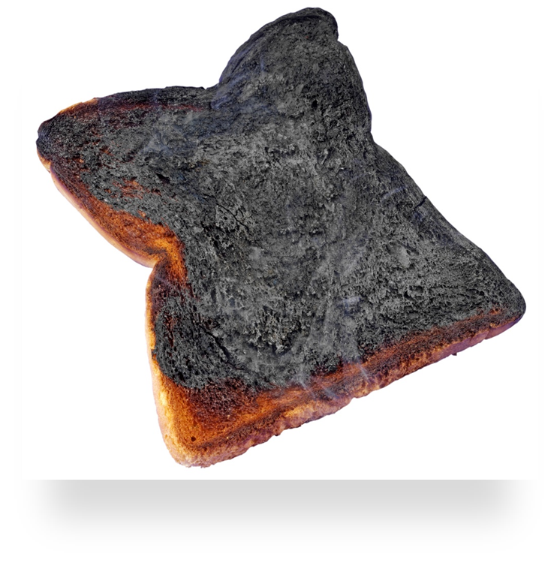
Possible Indicators of Burnout
Exhaustion
Lack of Motivation
Frustration, Cynicism, Negative Emotions
Cognitive Problems
Slipping Job Performance
Interpersonal Problems at Home and at Work
Not Taking Care of Oneself
Being Preoccupied with Work. . . When Not at Work
Generally Decreased Satisfaction
Health Problems
From: Gerry, Lisa M. “Ten Signs You’re Burning Out.” Forbes.com, April 1, 2013.

Slide 17
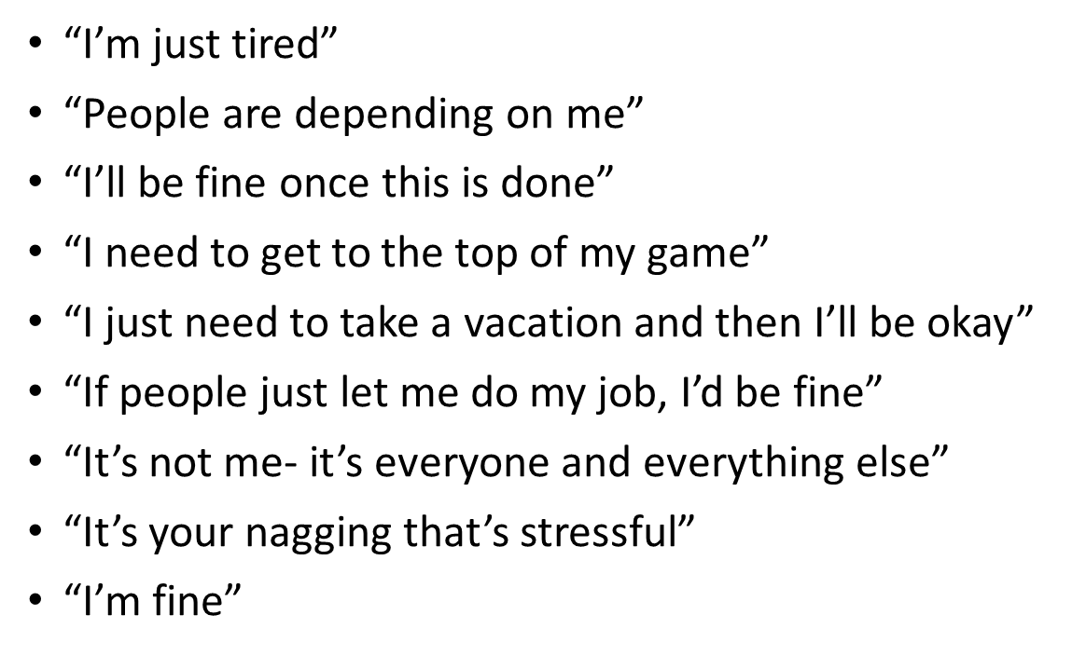
Common Statement We Say/Hear when We’re Burned Out

Slide 18
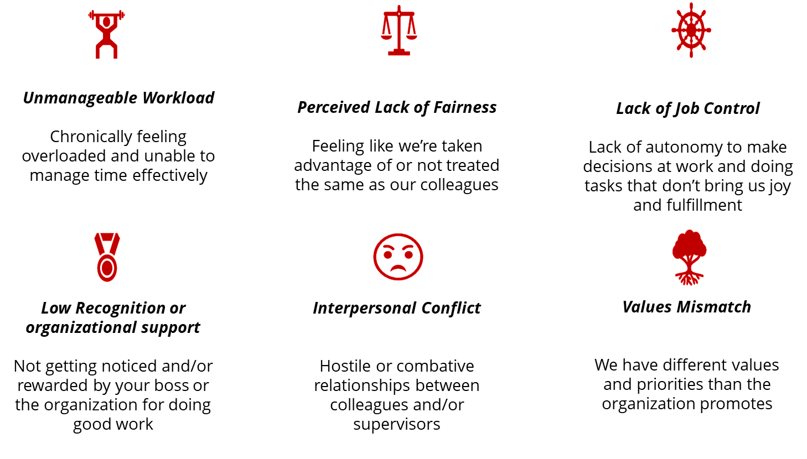
What Contributes to Burnout?

Slide 19
What Can I do about my own Burnout?

Slide 20
Ways to Address Burnout with your Team
Remind staff how they matter as individuals and how their work aligns with team/organizational goals
Set challenging yet attainable performance goals
Enforce reasonable work hours and help staff assess their workload
Solicit feedback from staff on progress toward their personal and professional goals
Provide meaningful recognition to your employees
Ensure that staff know how to recognize burnout in themselves and their colleagues
Support physical activity and time to engage in self-care throughout the workday

Slide 21
Ways to Address Burnout with your Team
Ensure staff can participate in the things they want to do and know why they keep coming to work
Do employees have the time do pursue their interests?
How can I ensure staff know it’s ok to pursue activities that interest them at work?
How can we connect people’s work to our vision and strategic objectives?
Help staff connect their work to organization’s mission/vision and strategic objectives
Have transparent discussions about what burnout looks/feels like and what’s causing burnout on the team
What causes us to feel burned out and what are your ideas to address it?
What’s 1 thing that we can do to support each other when we’re feeling burned out?
Let people know that you care about them as people…not just as employees
Transparently discuss what’s being done to address workload/staffing

Slide 22
Hard time getting mentally ready for work or getting to work on time
Feeling blah, weary, or hopeless
Thinking about your work/patients all the time
Loss of enjoyment in work and other activities
Trouble sleeping
Co-workers are annoyed with you
Patients are overly familiar and clingy

Slide 23
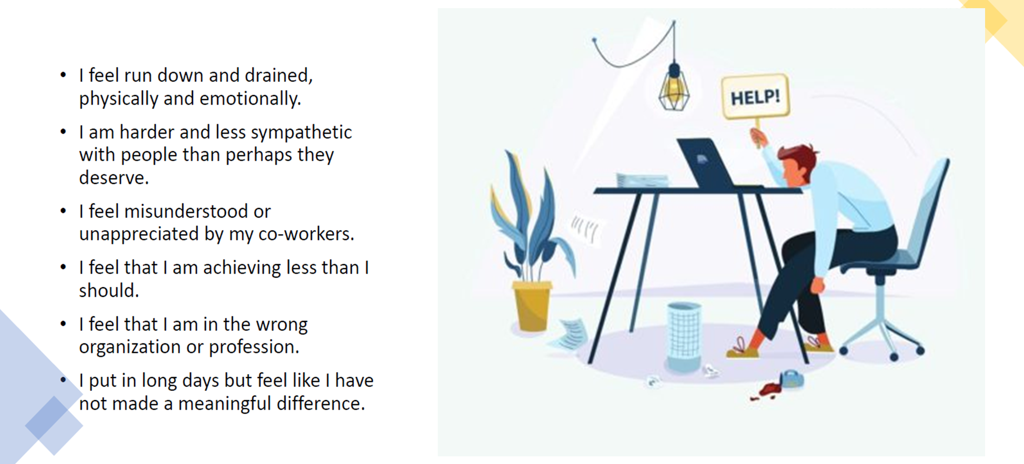
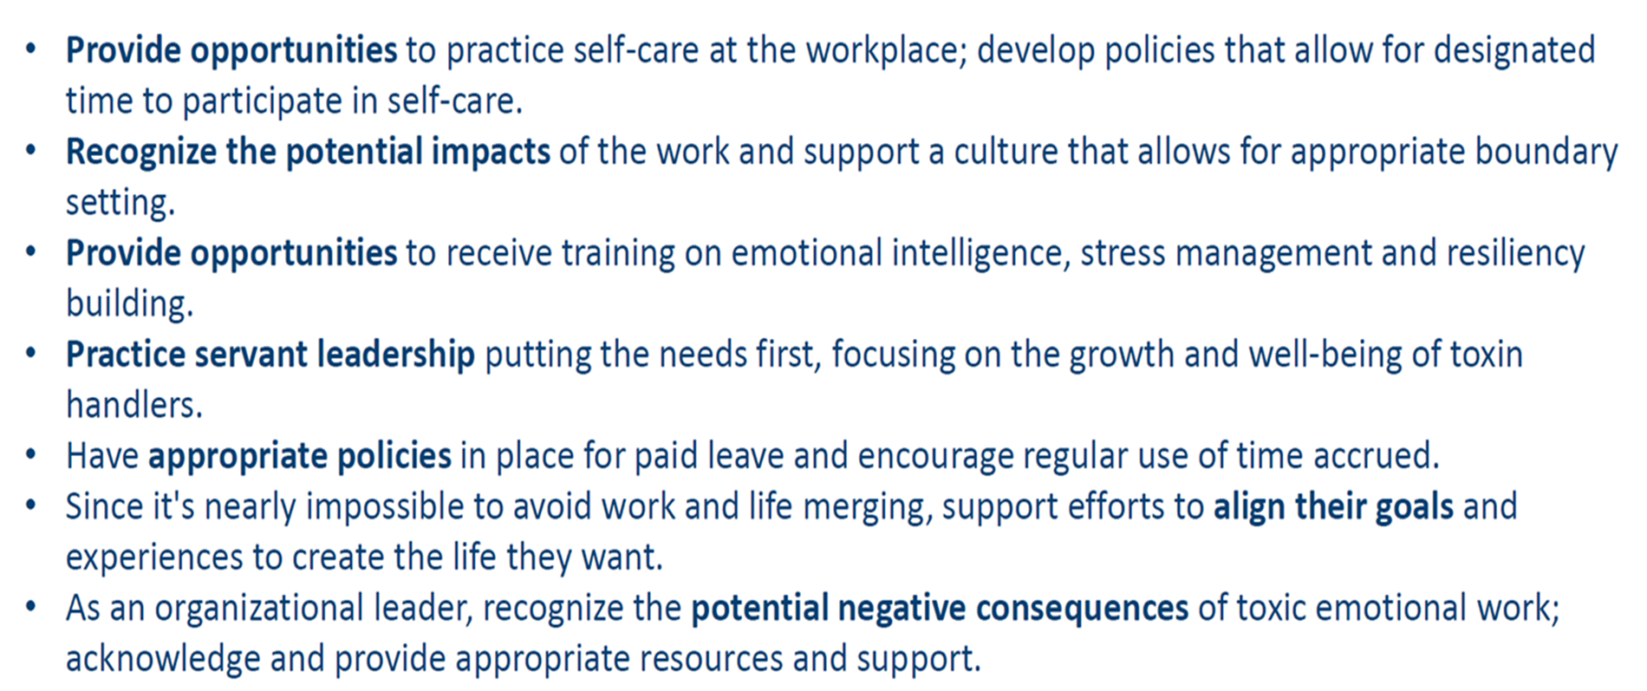
Am I Burned Out?

Slide 24
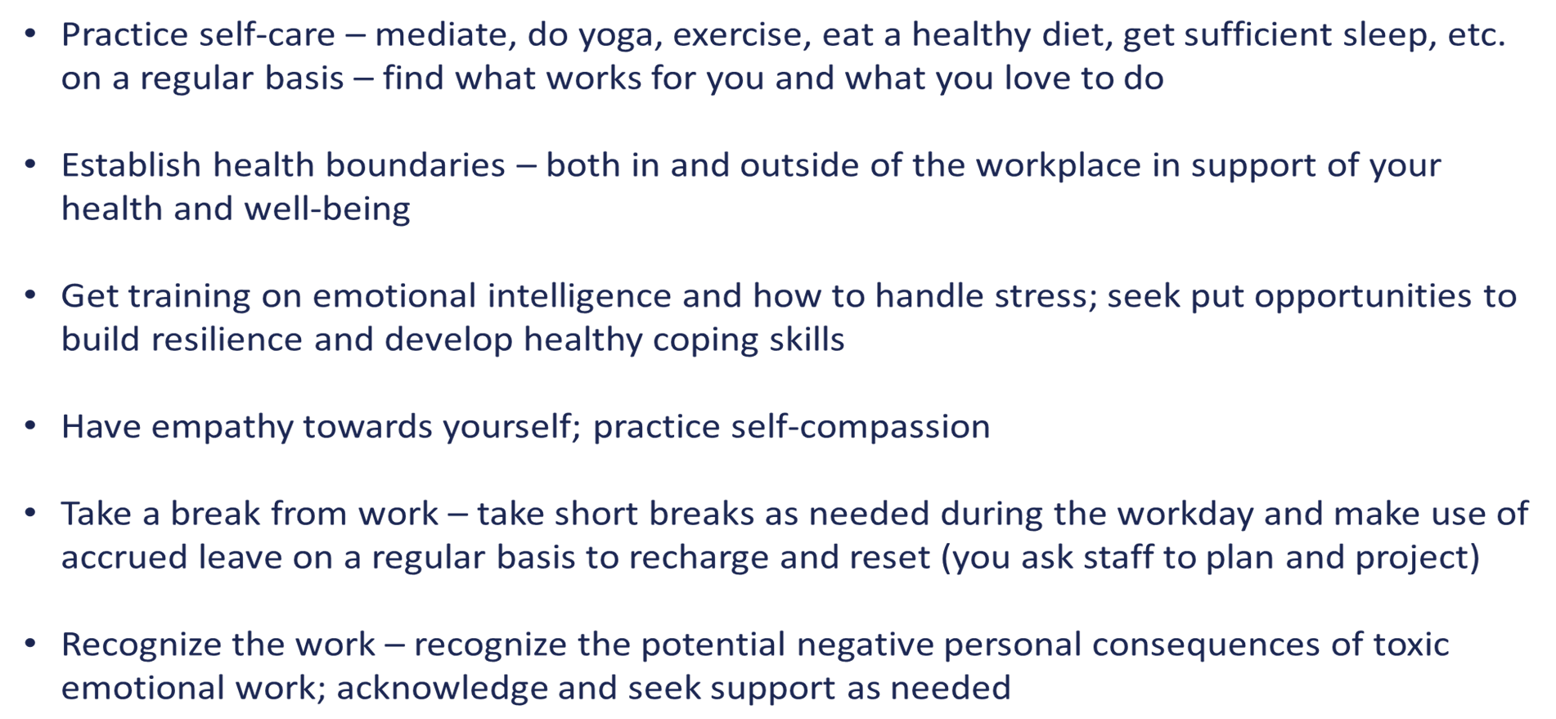
Personal Self-care Strategies

Slide 25
Great Organizational Strategies to Support Supervisors

Slide 26
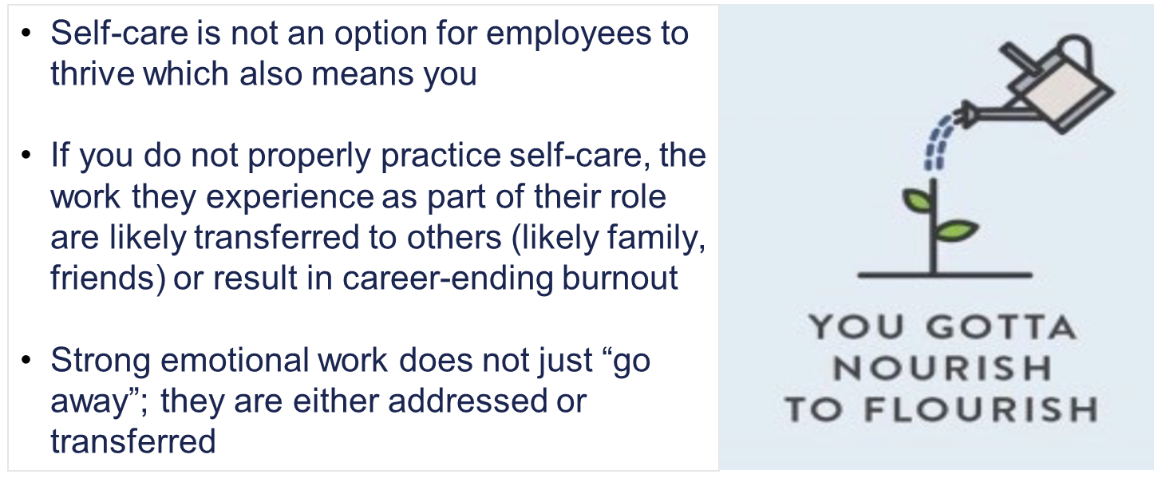
Self-care for Supervisors: Bottom Line

Slide 27
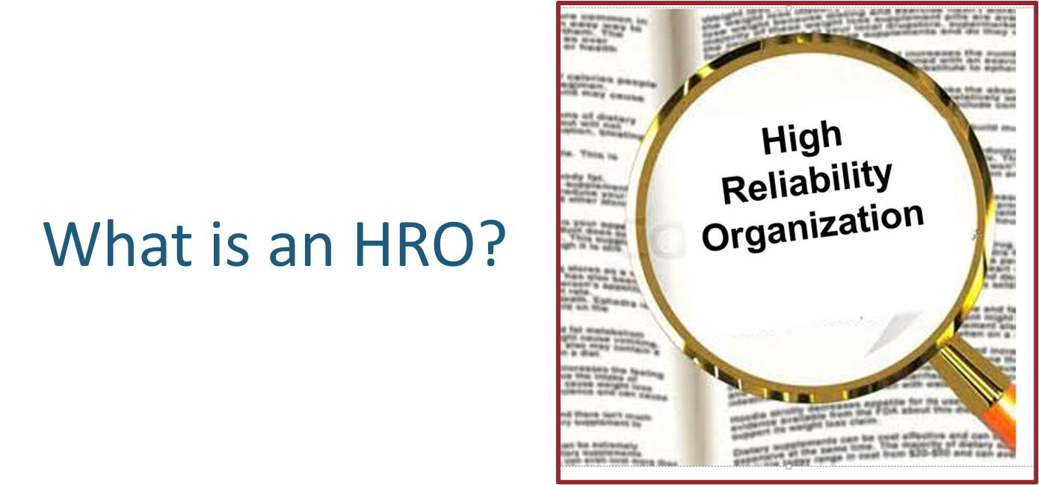
What is an High Reliability Organization (HRO)

Slide 28
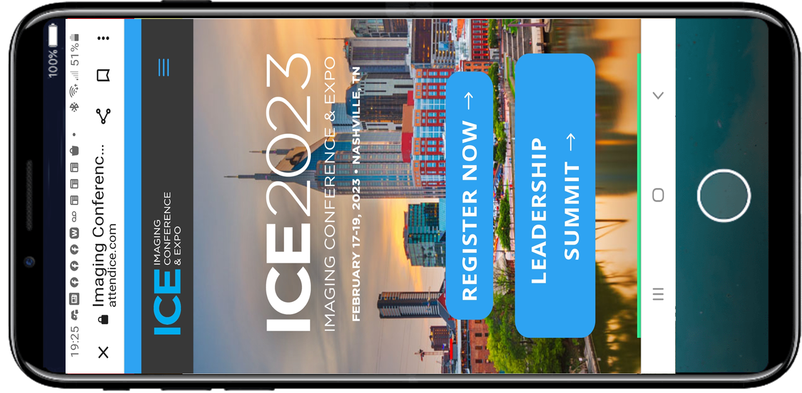

Slide 30
Imperatives of an HRO

Slide 31
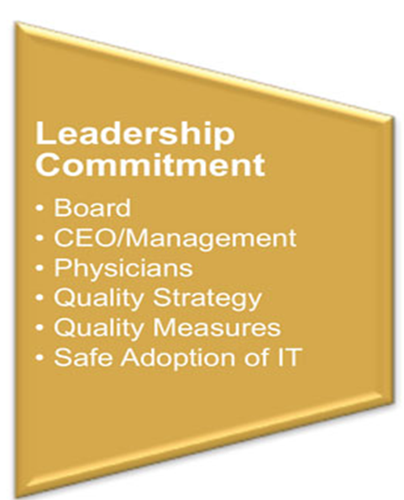
Connecting Well-Being and HRO
Leadership Commitment/Engagement is the cornerstone of any successful change
Nothing is successful or longstanding without it – if we model it… it becomes contagious
If we don’t, any project or new method is destined to fail
If not you, then who?

Slide 32
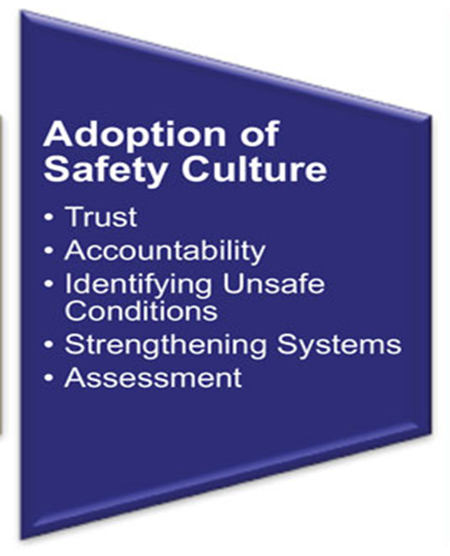
Connecting Well-Being and HRO
We all want to be part of an organization that values and trusts us
When we feel safe we are not afraid to call out things that may cause further damage
Accountability “destresses” the environment and makes the workplace something that people want to return back to

Slide 33
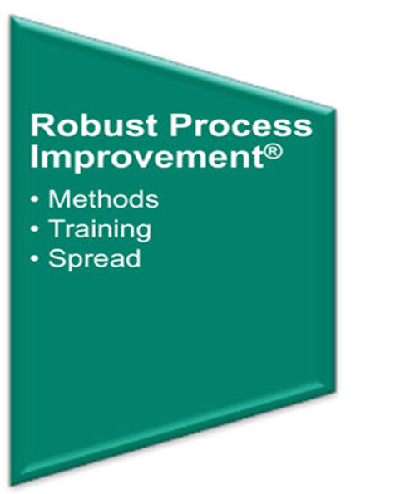
Connecting Well-Being and HRO
When we have an environment that demonstrates leadership commitment and support while also in a celebrating a culture of safety mindset:
There will be a natural desire to be safe
People will feel ownership
Attitudes will be improved

Slide 34
Communication and Something Called Engagement

Slide 35
“Engagement is not a characteristic of employees, but rather an experience created by organizations, managers and team members” - Unknown
https://www.gallup.com/workplace/393497/world-trillion-workplace-problem.aspx
Notes:
Often leaders think that if employees aren't leaving they must be engaged, however retention is very different from engagement. Employee engagement is a measurement of an employees involvement, satisfaction, happiness and loyalty with their work.
most healthcare organizations conduct an annual engagement survey and employees are left wondering, “Will this really make a difference?”
Professional paradise - a mindset that drives positive actions that lead to positive outcomes. Change the way you talk (or don’t talk) about employee engagement for the organization

Slide 38
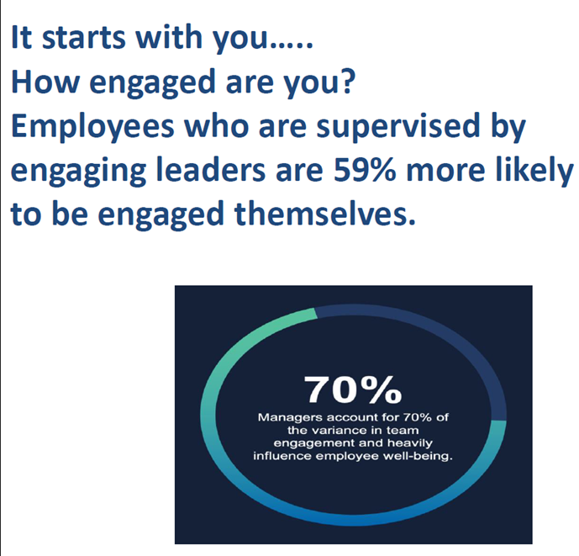
The Importance of Employee Engagement

Slide 39
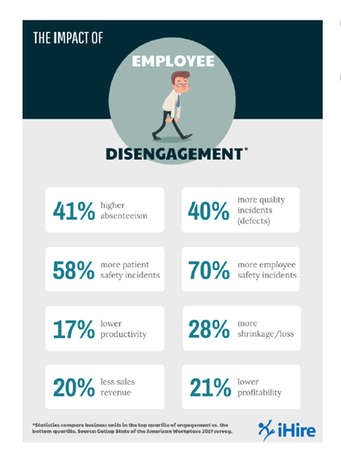
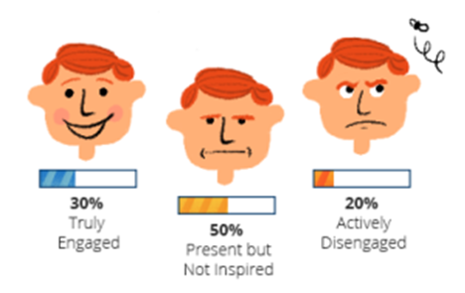
The Importance of Employee Engagement
The approximate cost of active disengagement to the US economy each year averages $550 Billion
Within the Federal Government the lost employee productivity is $65 Billion p/yr.

Slide 40
The Importance of Employee Engagement in Healthcare

Slide 41
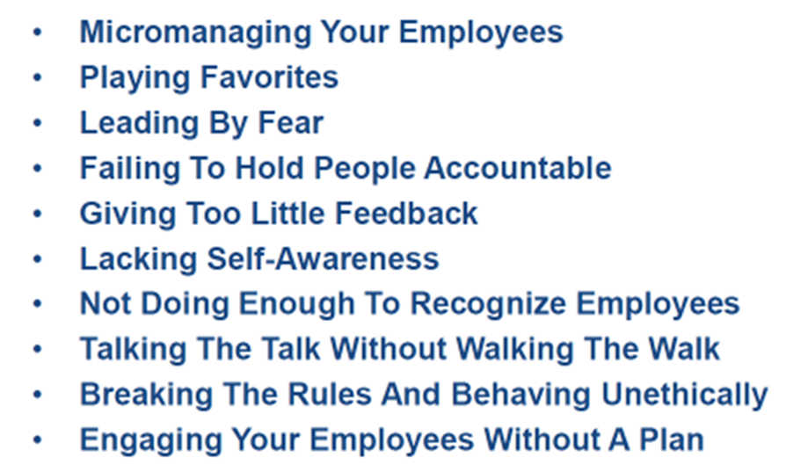
Leadership Behaviors that Contribute to Disengagement

Slide 42
The Great Resignation

Slide 43
Top 10 Drivers of Employee Engagement

Slide 45
You Cannot Have Great Engagement without
Communication

Slide 46
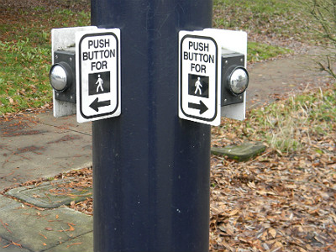
Crosswalk of Communication and Engagement
https://www.multibriefs.com/briefs/exclusive/trusting_the_crosswalk_button.html#.YshE03bMJro
Notes:
Imagine driving your car with the windows down on a nice cool summer day
Your attention is directed to a pedestrian assaulting the crosswalk button. They're not pushing the button once, but hitting it in rapid succession.
Subsequent pushing of the button does not re-energize the activation mechanism — this is energy lost by the pedestrian. In our attempts to communicate, the message should only have to be delivered once.

Slide 47
Crosswalk of Communication and Engagement
The same is true in organizational communications. Two messages provide the opportunity for crossed wires and ambiguity regarding which direction one intends. Of course, it's sometimes necessary to change paths, but only pushing the button once is necessary. Most crosswalk signals do not have a cancel feature — unlike our organizations.
https://www.multibriefs.com/briefs/exclusive/trusting_the_crosswalk_button.html#.YshE03bMJro

Slide 48
Crosswalk of Communication and Engagement
When pedestrians think they have waited too long for the crosswalk signal, they sometimes jaywalk and run the risk of getting hit by cars
When individuals feel they have waited too long for communicative feedback, they organizationally jaywalk
https://www.multibriefs.com/briefs/exclusive/trusting_the_crosswalk_button.html#.YshE03bMJro

Slide 50
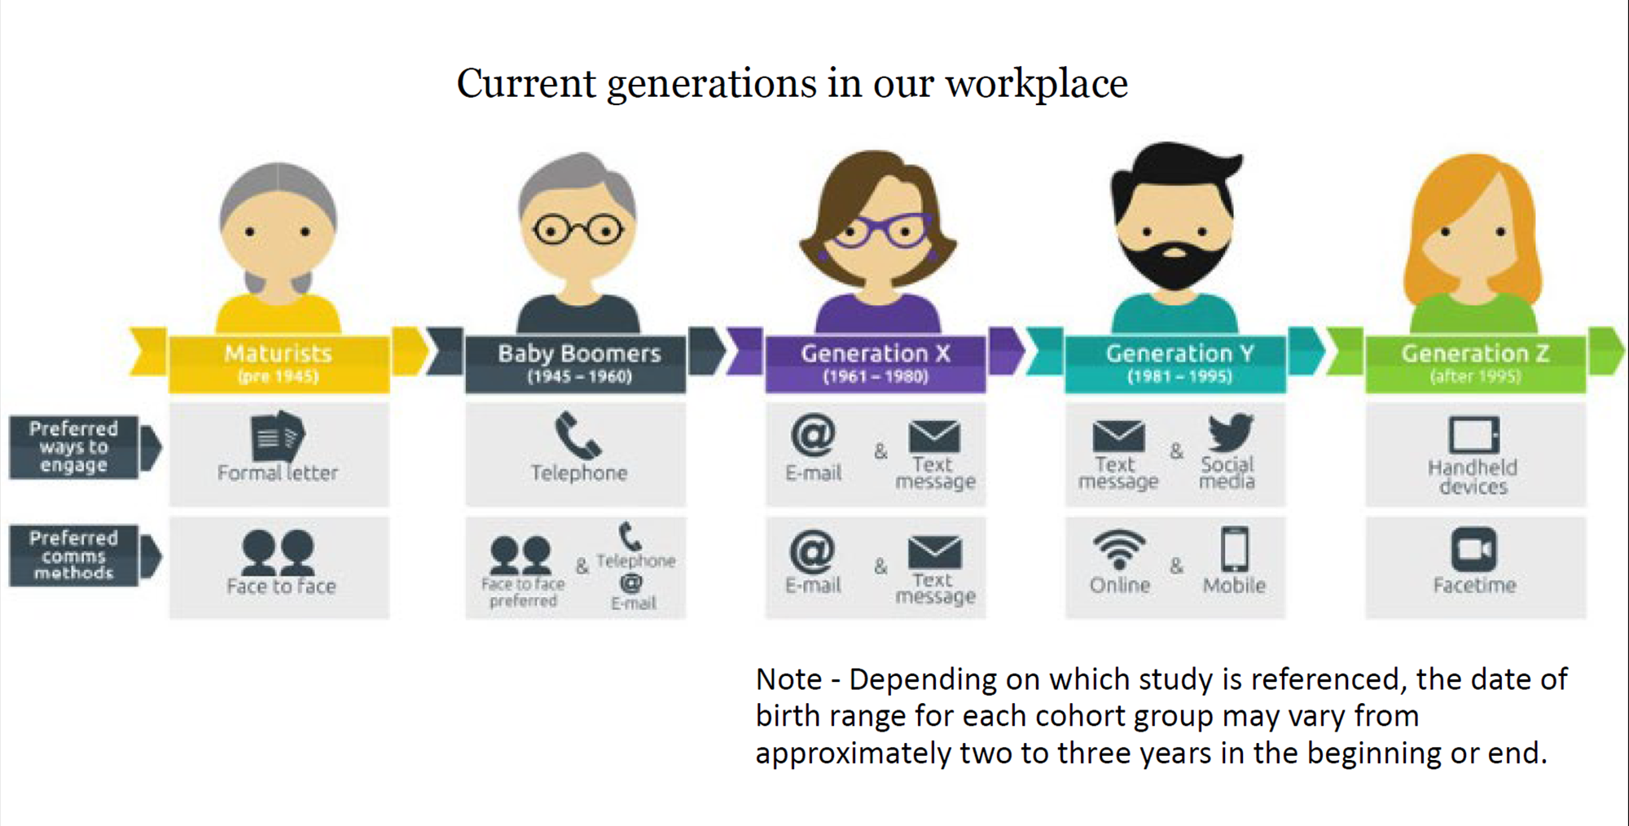

Slide 52
What are your thoughts?

Slide 53
Operations Management in Radiology Textbook
“Leadership may be the most difficult of the core concepts to implement… cannot be accomplished without leadership and high-level organizational support… who must clearly communicate and demonstrate their commitment to a culture of process improvement and change. ”
Foreman, M. S., Hubbard, L., &amp; Márquez Luis O. (2010). In Operations Management in radiology (1st ed., pp. 266–266). essay, American Healthcare Radiology Administrators.

Slide 54
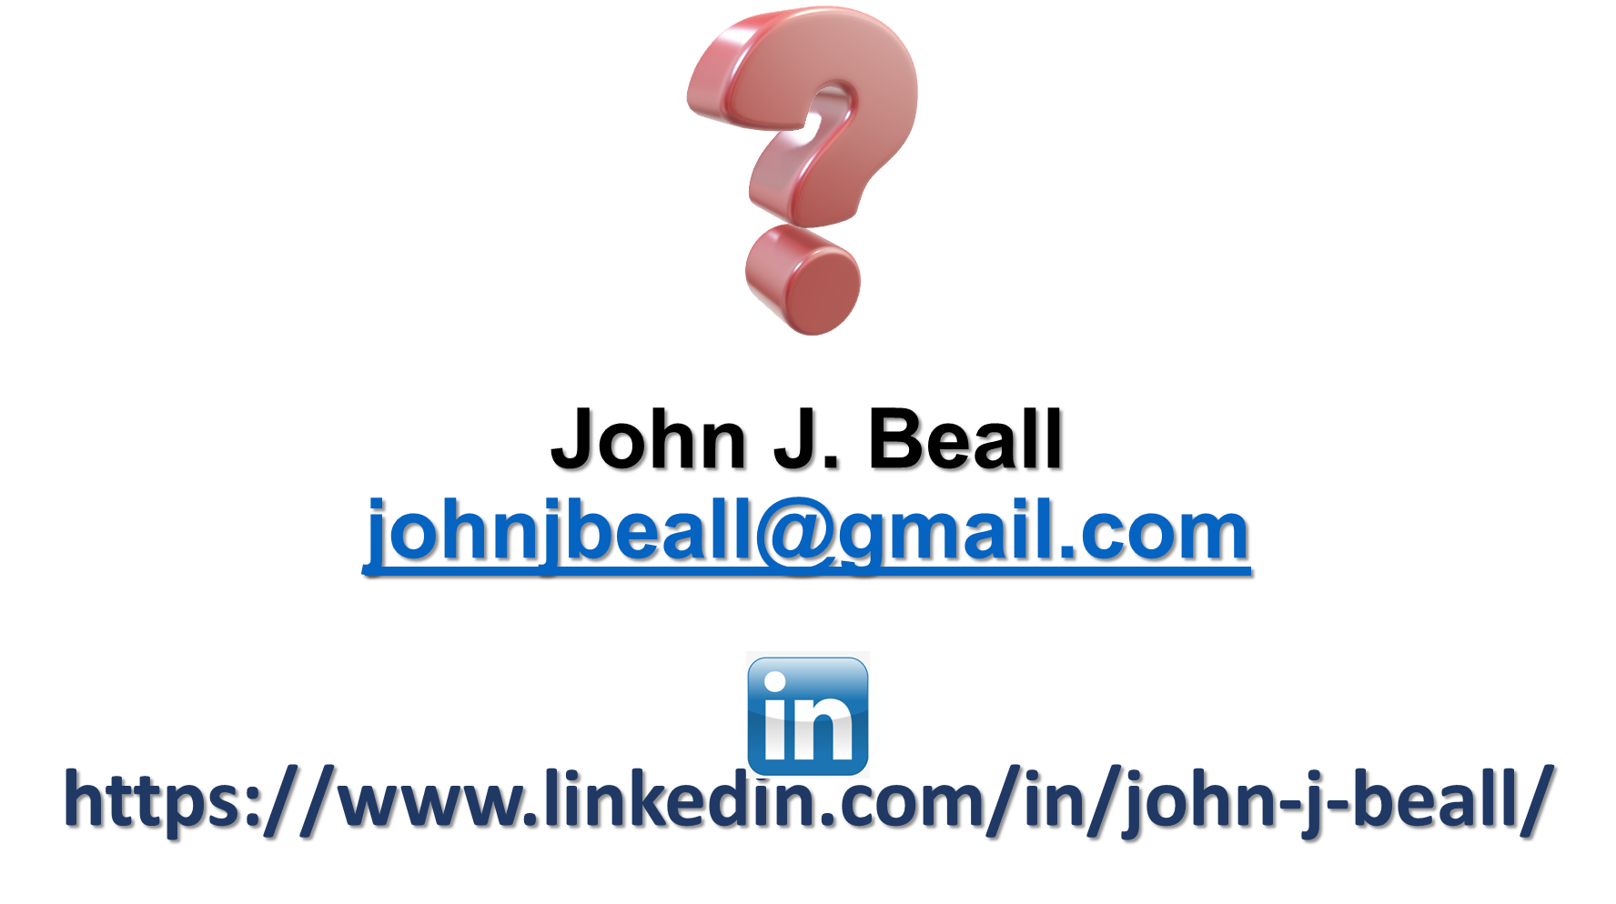

Slide 55
3 Easy Steps to Win $100!
Take a picture
Post on social media using #AttendICE
The attendee who uses the hashtag most throughout the conference will win a $100 gift card!!

