Slide 1
Employee Happiness and Retention Strategies that Work: Money isn’t Everything
Josh Laberee,Advanced Imaging Partners
Advanced Diagnostic Consulting Group

Slide 2
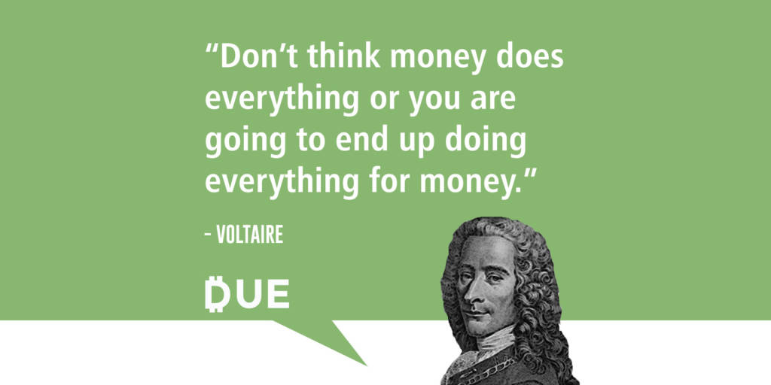

Slide 3
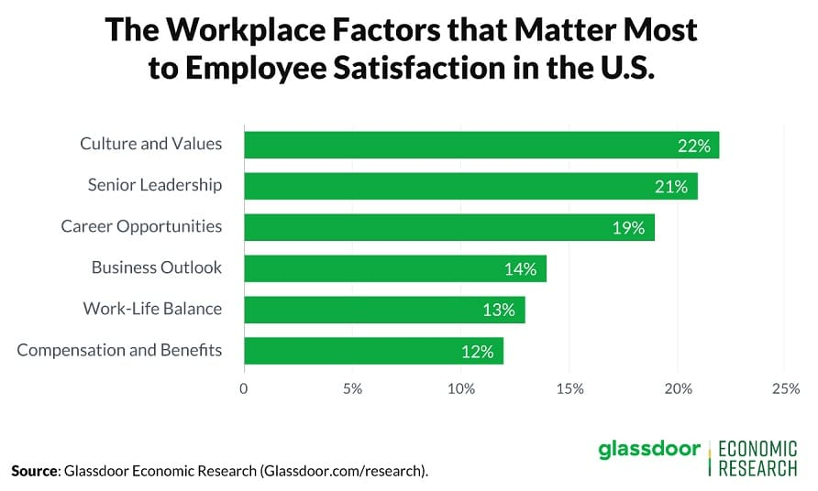
Why Do Good Employees Leave?

Slide 4
Why Do Good Employees Leave?
Fill out Your Questionnaire in Front of You.
Be honest with yourself and about
Your Employer.

Slide 5
Why Do Good Employees Leave??
1. NO APPRECIATION

Slide 7
SHOWING APPRECIATION
MAKES EMPLOYEES
FEEL VALUED!

Slide 8
Why Do Good Employees Leave??
2. Poor Management

Slide 9
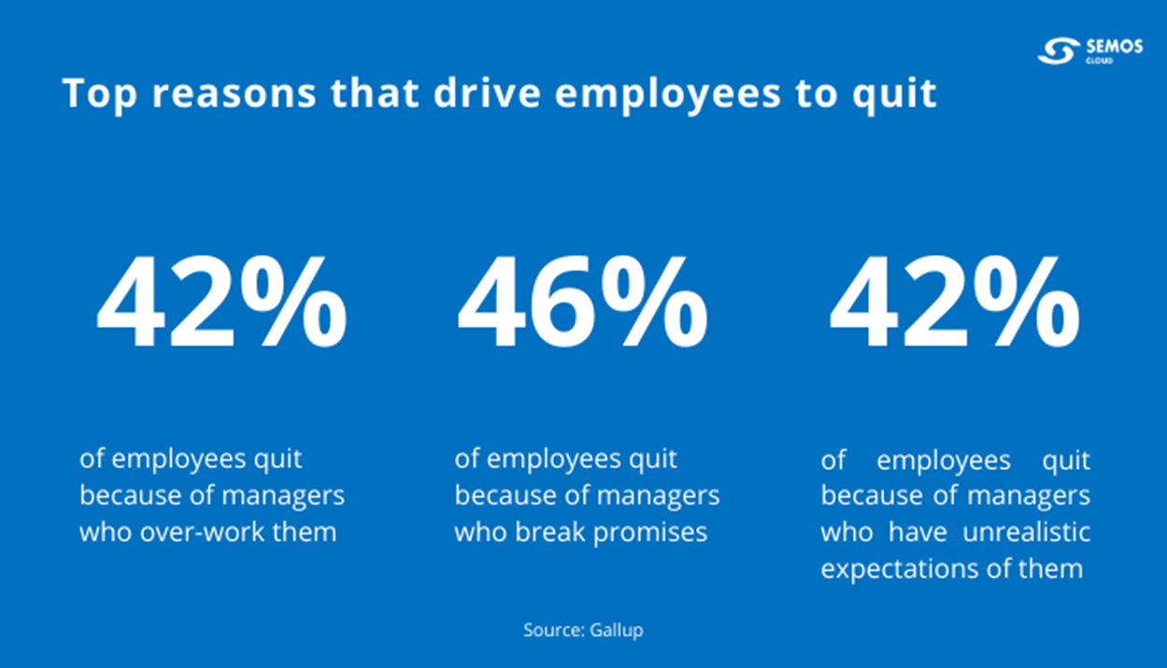

Slide 10
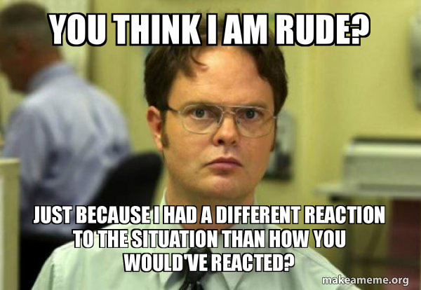
Why Do Good Employees Leave??
3. Rude Behavior

Slide 11
Assigning blame to others
Playing favorites among management
Retaliation
Disrespectful behaviors and attitudes

Slide 12
Why Do Good Employees Leave??
4. No Training, Education or Advancement

Slide 14
Why Do Good Employees Leave??
5. Micromanagement

Slide 15
Micromanagers focus on mistakes and weaknesses rather than highlighting achievements and efforts. No matter how hard an employee works, they never feel like their work is good enough.

Slide 16
Why Do Good Employees Leave??
6. Negative Corporate Culture
Most employees want to work for companies that mirror their principles.

Slide 17
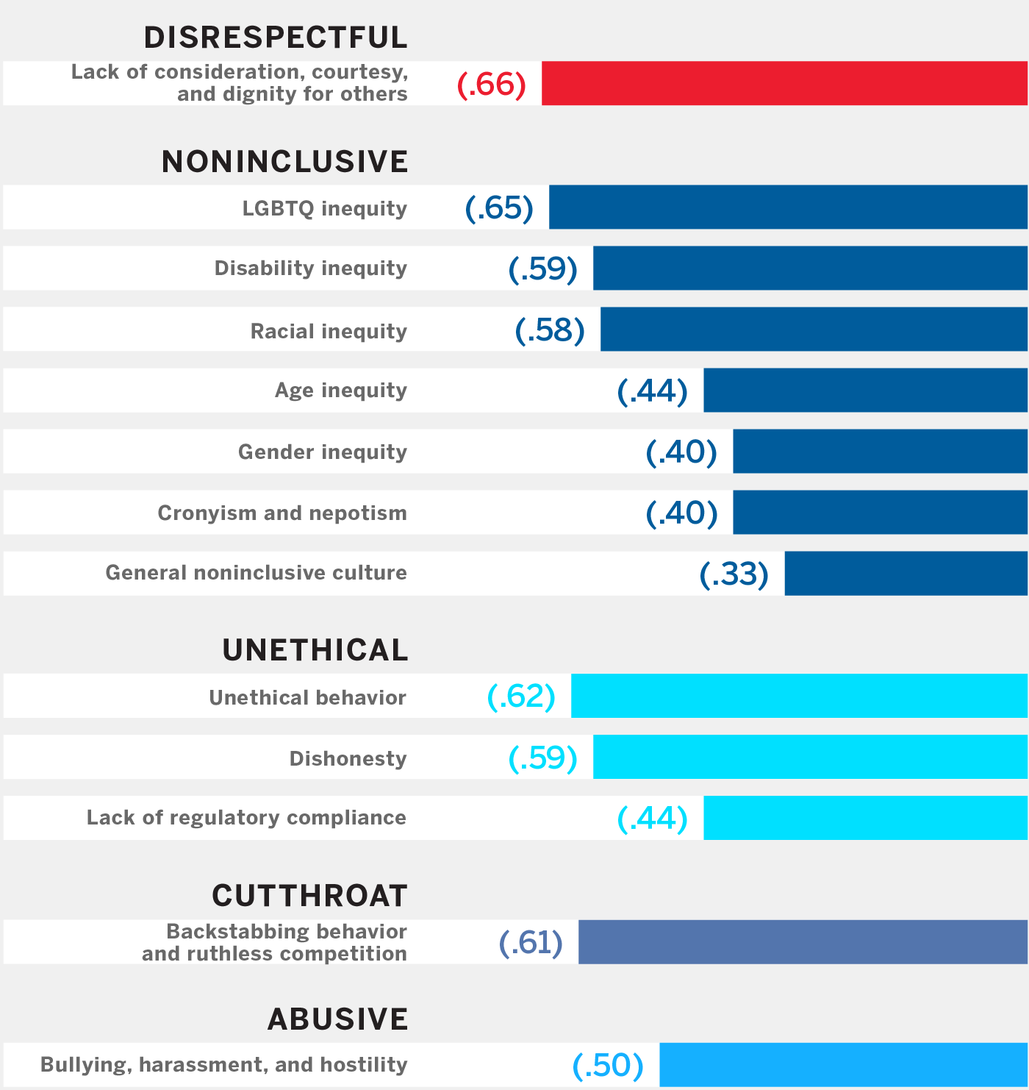
https://sloanreview.mit.edu/article/why-every-leader-needs-to-worry-about-toxic-culture/

Slide 18
Why Do Good Employees Leave??
Lack of Employee Wellbeing

Slide 20
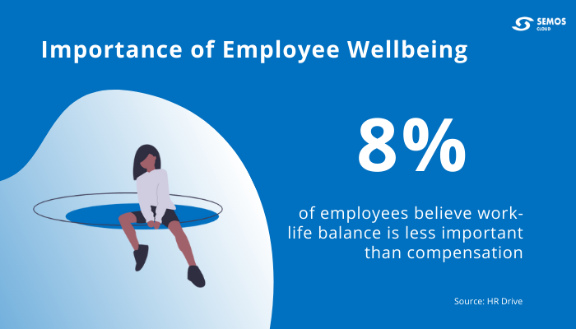

Slide 21
Get To Know Your Employees!
What Motivates One Person
May Not Motivate Another.
Bottom Line: Is Your Organization 'Selling' What Employees Want to Buy?

Slide 22
Get To Know Your Employees!
How can we offer a more attractive workplace environment in healthcare?

Slide 23
DISC Personality Quiz

Slide 24
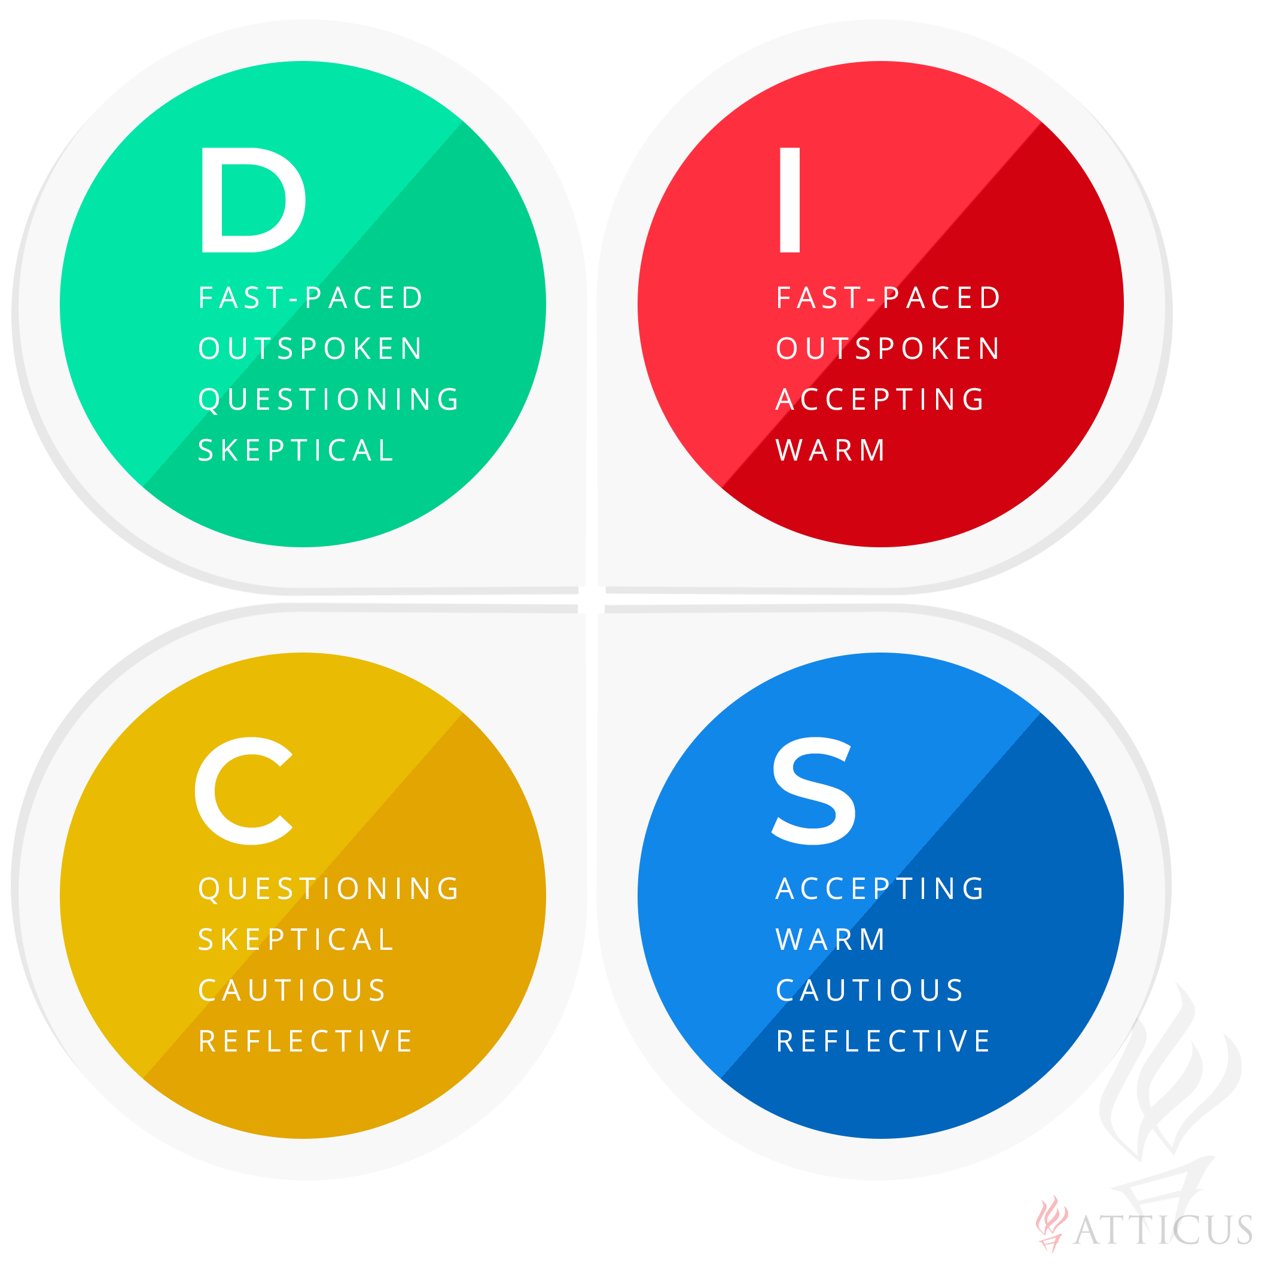

Slide 25
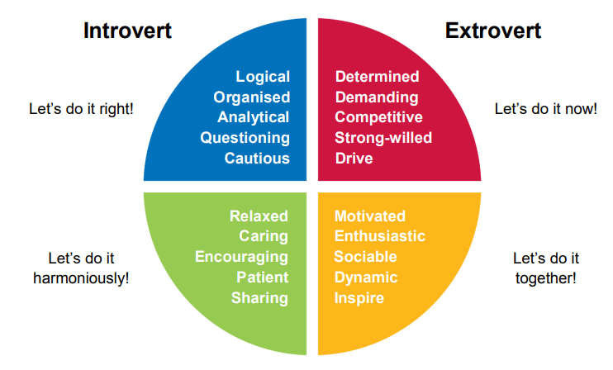

Slide 26
Personality Survey Time!
Take 5 minutes to find out what are you?
Lions
Otters
Golden Retrievers
Beavers

Slide 27
Everyone Break Into Your Animal Groups!
Lions
Otters
Golden Retrievers
Beavers

Slide 28
As a group answer the following questions on your hand out.

Slide 29
How to Hire?
Retention: How Do We Keep Good People?

Slide 30
A Glassdoor survey found that 80% of workers would rather have access to more perks and benefits than a relatively small salary increase.
https://www.shrm.org/resourcesandtools/tools-and-samples/hr-glossary/pages/employee-value-proposition-evp.aspx

Slide 31
Employee Value Proposition (EVP)
What is an employee value proposition (EVP)?
An employee value proposition (EVP) is part of an employer's branding strategy that represents everything of value that the employer has to offer its employees. Items such as pay, benefits and career development are common, but employers also highlight offerings that are currently in demand—like technology, remote work and flexible scheduling.

Slide 33
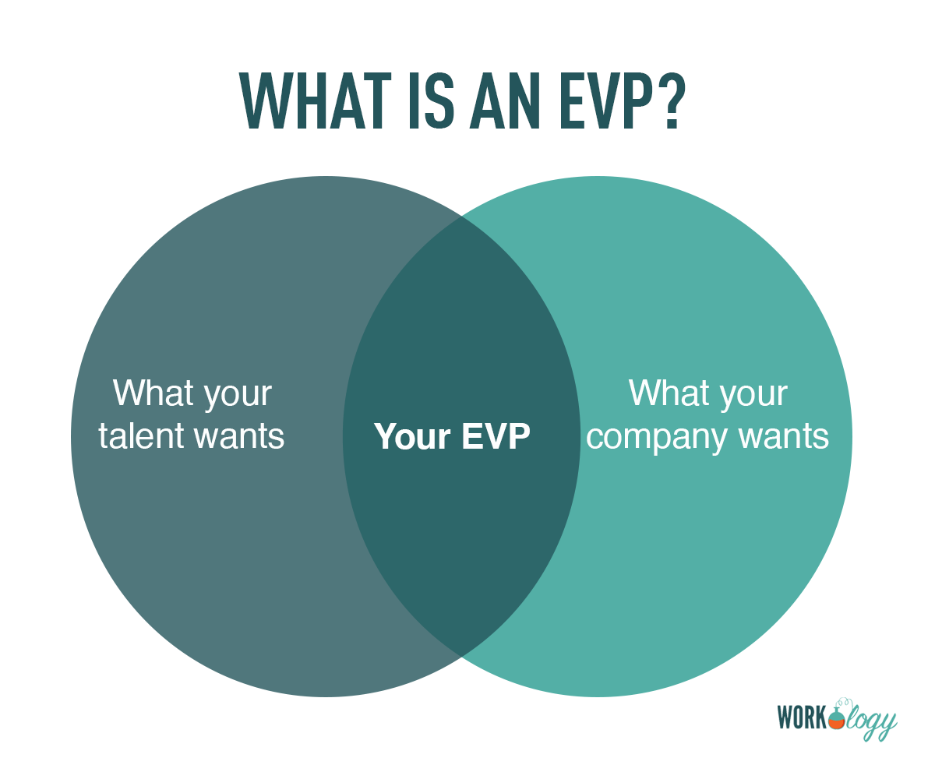

Slide 35
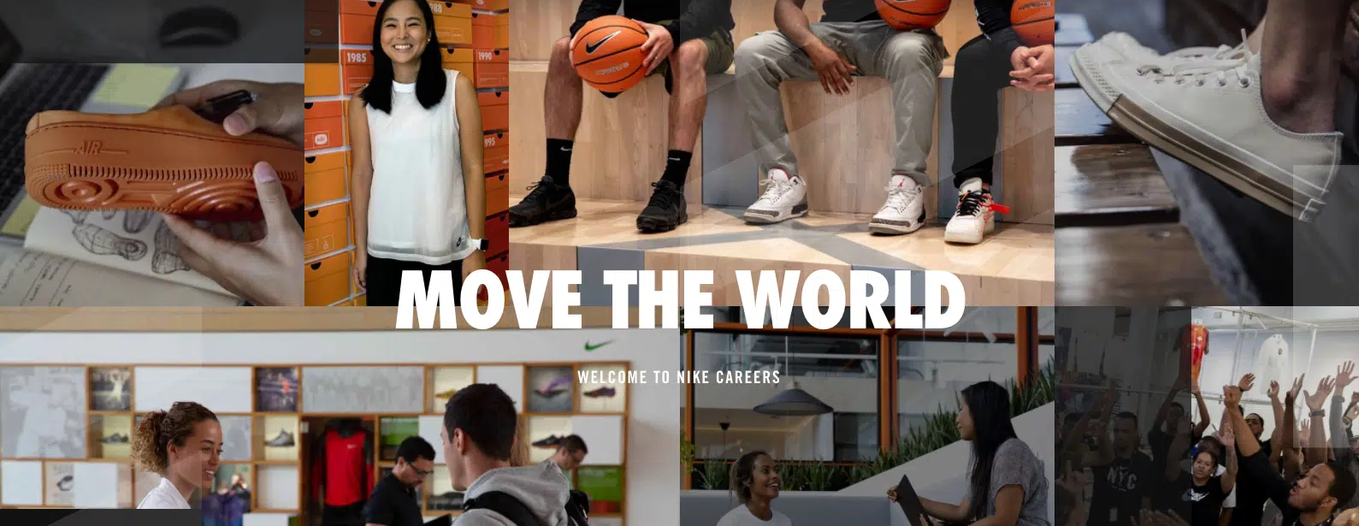
EVP Example 1: Nike

Slide 36
One of the headlines of Nike’s employee value prop is “Win as a team”. That sentiment filters across the company’s benefits and life at Nike depictions. Nike’s culture emphasizes accomplishing innovation in the world of sport with a team mentality. It approaches benefits and compensation with the same perspective. The company offers perks such as fitness discounts, relocation benefits, competitive pay and retirement plans, and advanced learning opportunities, among other things.

Slide 37
EVP Example 2: LinkedIn

Slide 38
EVP Example 3: Netflix

Slide 39
The company’s culture memo offers a very detailed breakdown of how the culture prioritizes “people over process”. It can be summed up in the five values:
1. Encourage independent decision-making by employees.
2. Share information openly, broadly, and deliberately.
3. Be extraordinarily candid with each other.
4. Keep only our highly effective people.
5. Avoid rules.

Slide 40
Final Assignment! Start your own EVP!

Slide 41
We have to change how we approach hiring in the healthcare industry. Be different by thinking differently.

Slide 42
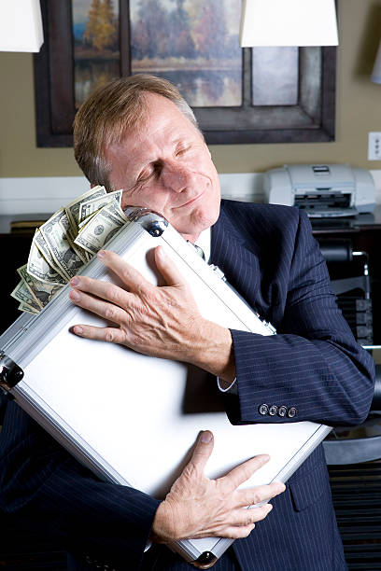
Thank You!

Slide 43
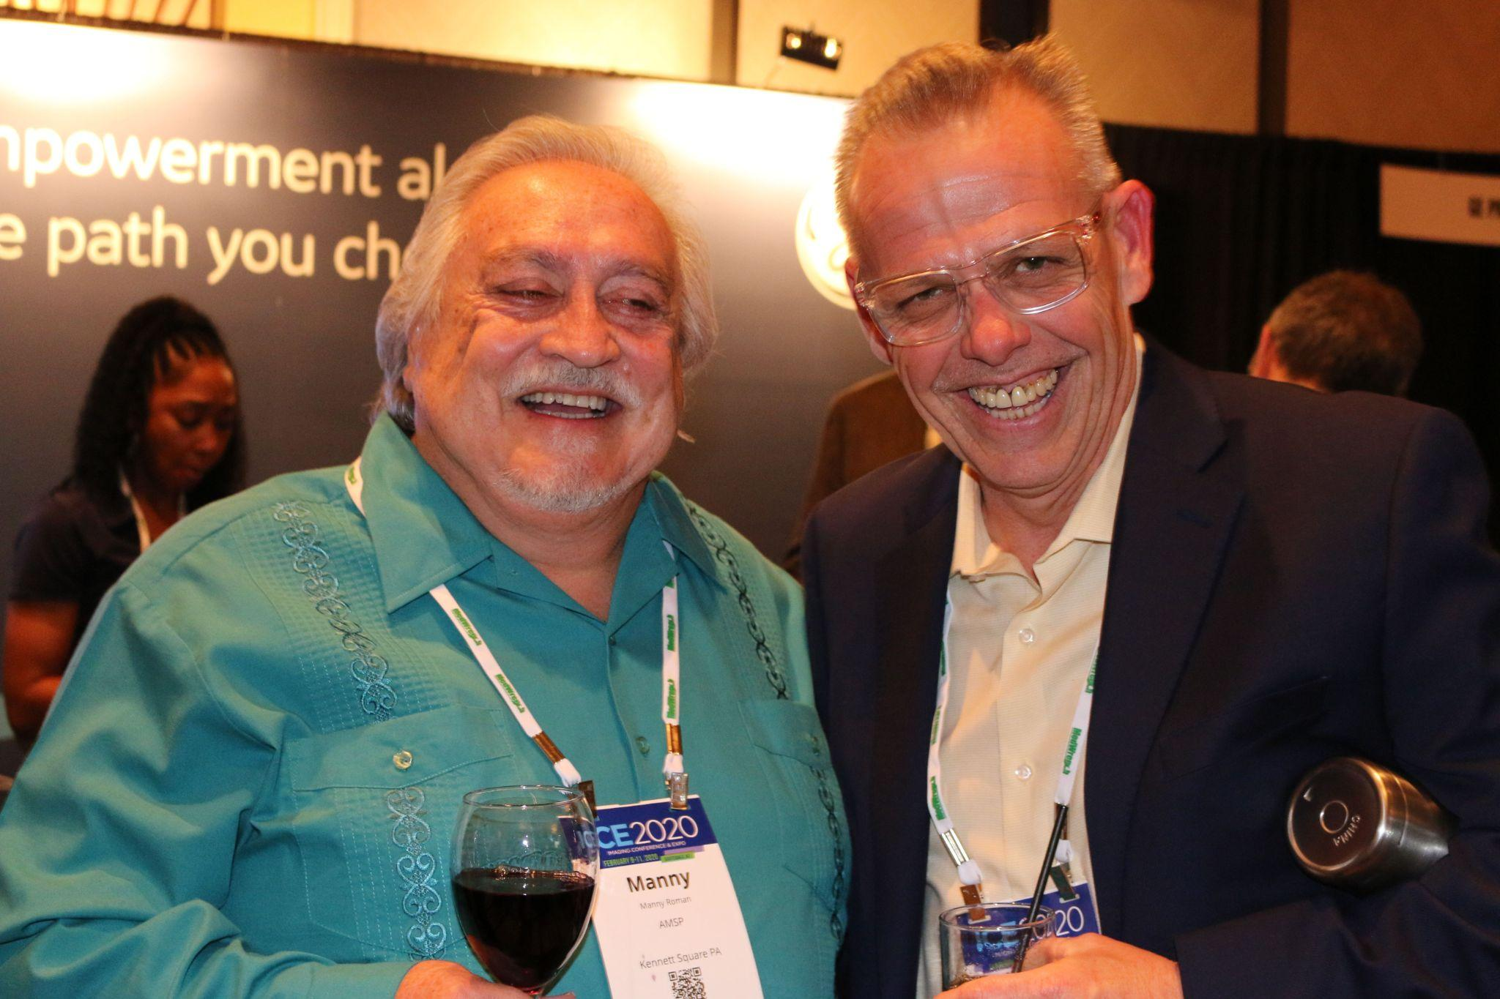
3 Easy Steps to Win $100!
Take a picture
Post on social media using #AttendICE
The attendee who uses the hashtag most throughout the conference will win a $100 gift card!!

