Slide 1
Print This! How 3D printing is helping to shape healthcare innovations
Chris Bryant
Lovell Federal Health Care Center

Slide 2
So…… what is it?

Slide 3
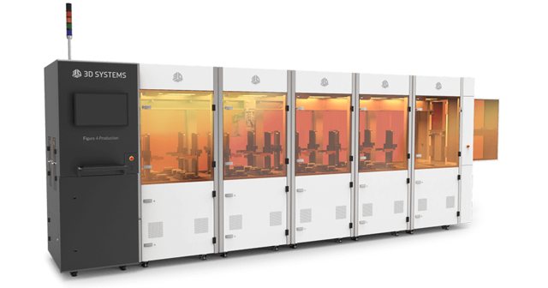
What kind of 3D Print /AM technologies are out there?
FDM
SLA
DLP
MJ
SLS
EBM
SLM
LOM
BJ

Slide 4
How does it work?
FDM = Fused Deposition Modeling
Developed by Scott Crump in the 1980’s
It uses production grade thermal plastic materials to print its 3D objects. The Plastic is melted to a liquid state and then extruded onto a build surface- row by row.
It’s popular for producing functional prototypes, concept models, and manufacturing aids

Slide 5
FDM

Slide 6
How does it work?
SLA = Stereolithography
Highly detailed and accurate method for fast prototyping.
Ultraviolet Lasers are used to cure the resin material layer by layer to create the object.
Mirrors direct the laser in an X and Y axis for each layer.
Completed builds are post processed- by an UV oven in some cases.

Slide 7
SLA

Slide 8
How does it work?
DLP= Digital Light processing
The oldest 3D printing technology developed. (1987)
Similar to SLA printing –but uses a different light source to cure the photopolymer resin.
It is also much faster than SLA since it builds an entire layer to light at once.

Slide 9
DLP

Slide 10
How does it work?
SLS = Selective Laser Sintering
Uses high power CO2 lasers to melt metal powders, but can also with nylon, or ceramic material as well.
The unmelted powder acts as support for the build object – so no support structures are needed.
Builds fully functional- ready to use prototypes.

Slide 11
SLS

Slide 12
How does it work?
SLM = Selective Laser Melting
Very similar to SLS, but instead of sintering the material- SLM fully melts it creating a stronger object.
Most common for building object with complex structures.

Slide 13
SLM

Slide 14
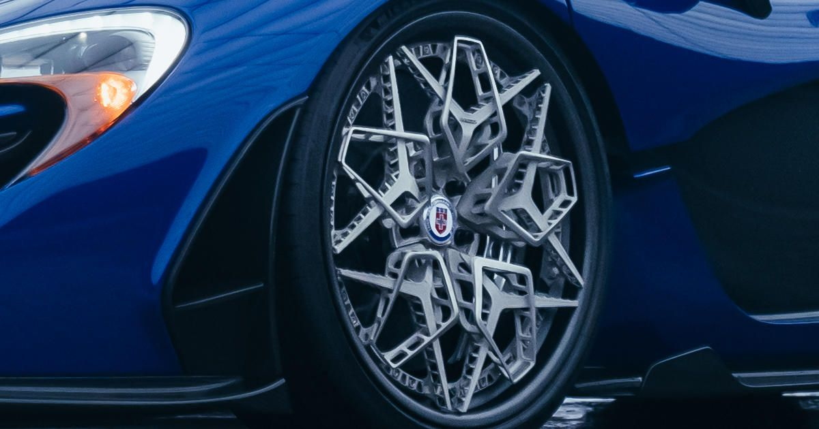
How does it work?
Electronic Beam Melting
Developed in Sweden in 1997 by Arcam.
Very Similar to SLM technology- also uses powder. Main difference is the fusing method: electron beam in a vacuum chamber.
Main advantage is that it can create fully functional parts on demand very quickly.

Slide 15
EBM

Slide 16
How does it work?
LOM = Laminated Object Manufacturing
LOM is a rapid prototyping method that it’s main advantage its cost effective.
Uses paper or plastic sheets which are adhered layer by layer and then cut out by a laser.
Mainly used by architects for design modeling.

Slide 17
LOM

Slide 18
How does it work?
BJ = Binder Jetting
It uses two materials to create an object: the powder based material, normally gypsum and a bonding agent.
The bonding agent is sprayed from a nozzle like an inkjet over the powder to create an object.
The advantage of BJ technology is being ablr to print in multiple colors- this is the primary technology for creating teaching models.
Last checked- one company boasted of 33K colors that they can print.

Slide 19
Binder Jetting

Slide 20
How does it work?
MJ = Material Jetting
Very old technology- based on wax casting that jewelers use to make molds.
The process is now automated with the wax being extruded layer by layer to create much more detailed molds.
One company uses a photopolymer resin to create molds for various industries that want highly detailed molds.

Slide 21
MJ Printing

Slide 22
Now what about the Filament?
Sand Stone
PLA
Flexible TPE
ABS
PET
Metal/ PLA
HIPS
Glow In The Dark
PVA
Amphora
NYLON
WOOD
PTE+G
Carbon Fiber
Conductive PLA

Slide 23
Filament: ABS
Acrylonitrile Butadiene Styrene = ABS
ABS is idea for functional prototypes. It is a very strong light weight filament.
It is also slightly flexible which makes it very durable- you can drop it and it wont shatter like a resin can.
It has a higher working tempature and the builds can warp if it is not in a enclosed space.

Slide 24
Filament: PLA
Polylactic acid or PLA= PLA
It has over taken ABS recently in popularity with PLA variations to make it less brittle and more temperature resistant.
It is much more environmentally friendly- it is a biodegradable material: it wont create fumes when printing with it.
It is normally comprised of renewable resources like corn starch or cane sugar.
Because of the ability to degrade over time and is biocompatible- The FDA has cleared specific materials to be used in surgical procedures.

Slide 25
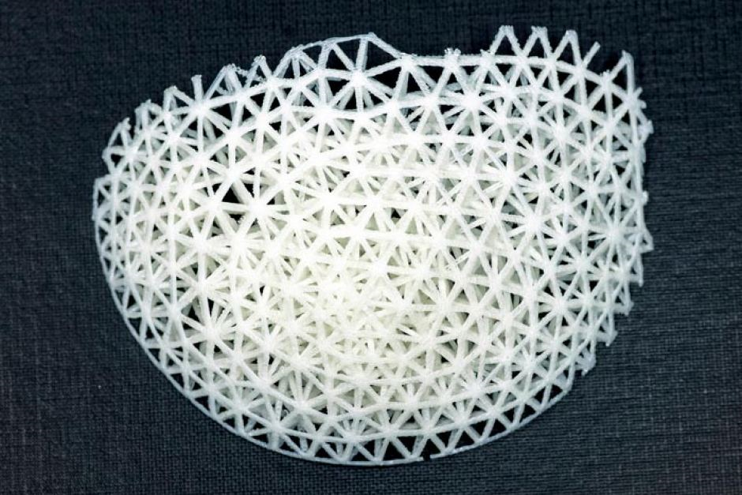
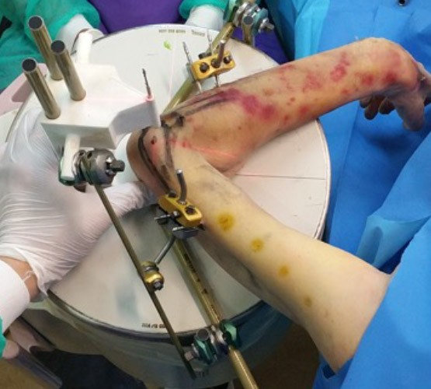
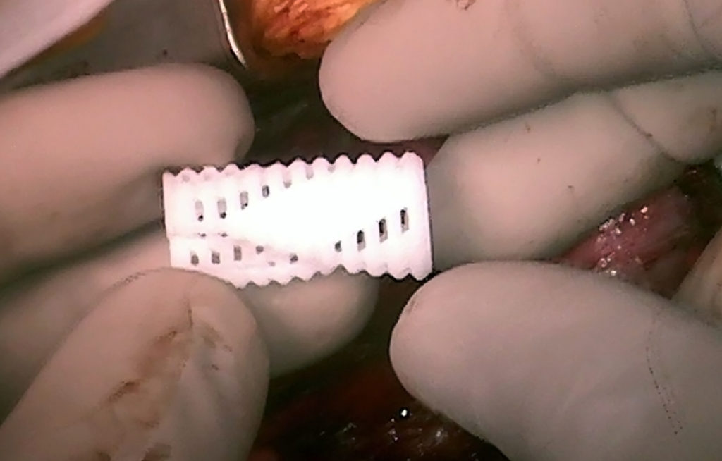
Filament: PLA uses

Slide 26
Filament: PVA
Polyvinyl Alcohol = PVA
Its main property is that’s its water soluble.
Its used for making movable parts and supports for very detailed builds.

Slide 27
Filament : PVA - How it works

Slide 28
Filament: PETG
Newer filament that has some of the best features of ABS and PLA.
It is recycled from plastic bottles and does not produce fumes when printing with it and it can be recycled as well.
More flexible than ABS and is shockproof.
The only issue is that it will absorb moisture over time.
So the builds have to be sealed.

Slide 29
Can you print food?
Yup- you sure can! This Foodidni unit is created in Germany for printing food that Seniors might have difficulty swallowing and processing.

Slide 30
So what good is this technology?
What can we do with it to make health care better?
It already is improving outcomes
Could AM also make the environment better?
I believe so
Could it improve the quality of life for some?
Yes- and Ill show you an example

Slide 31
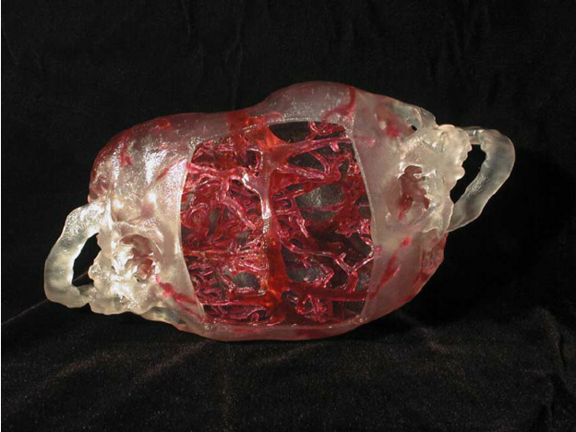
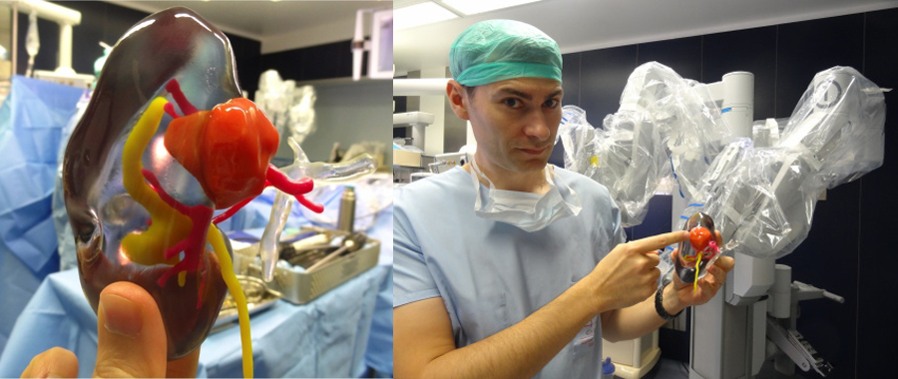
Surgical example

Slide 32
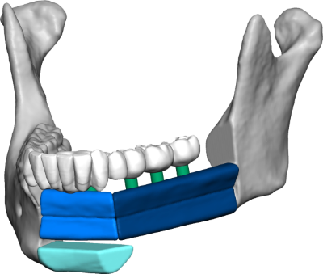
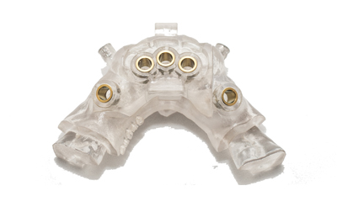
Dental Example

Slide 33
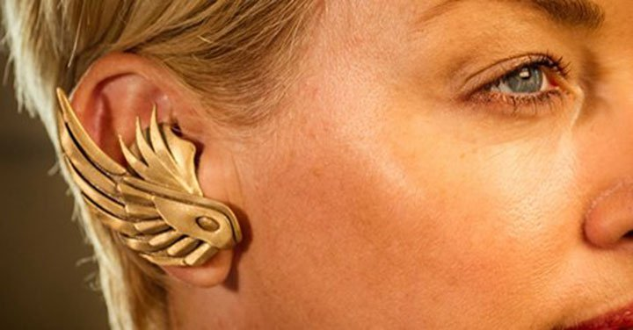
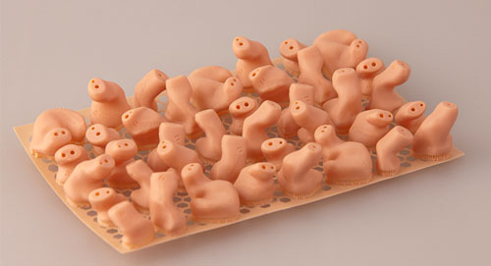
Audiology examples

Slide 34
Lets’ talk about the imaging and how it feed into the AM process.

Slide 35
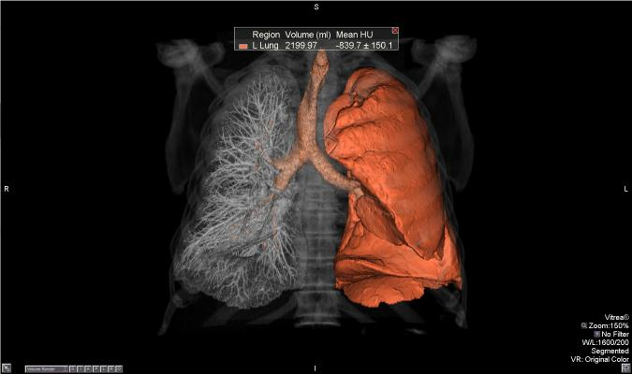
CT/MR capture

Slide 36
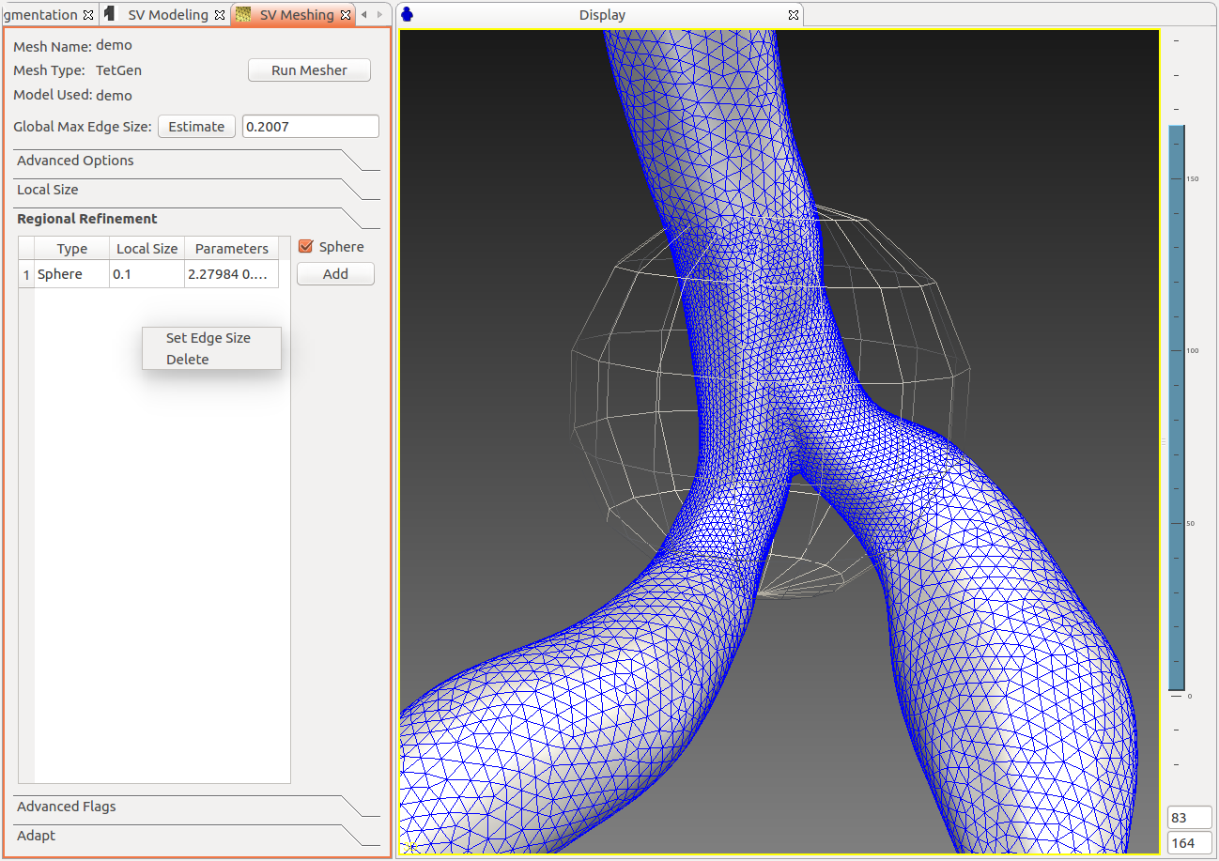
Fed into the 3D modeling software

Slide 37
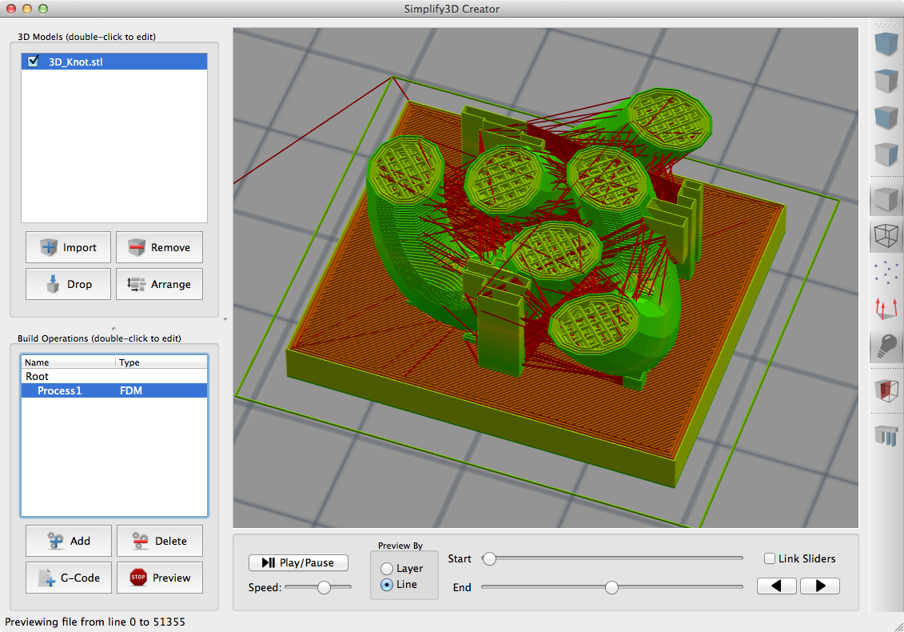
It is then “sliced”

Slide 38
And then Printed

Slide 39
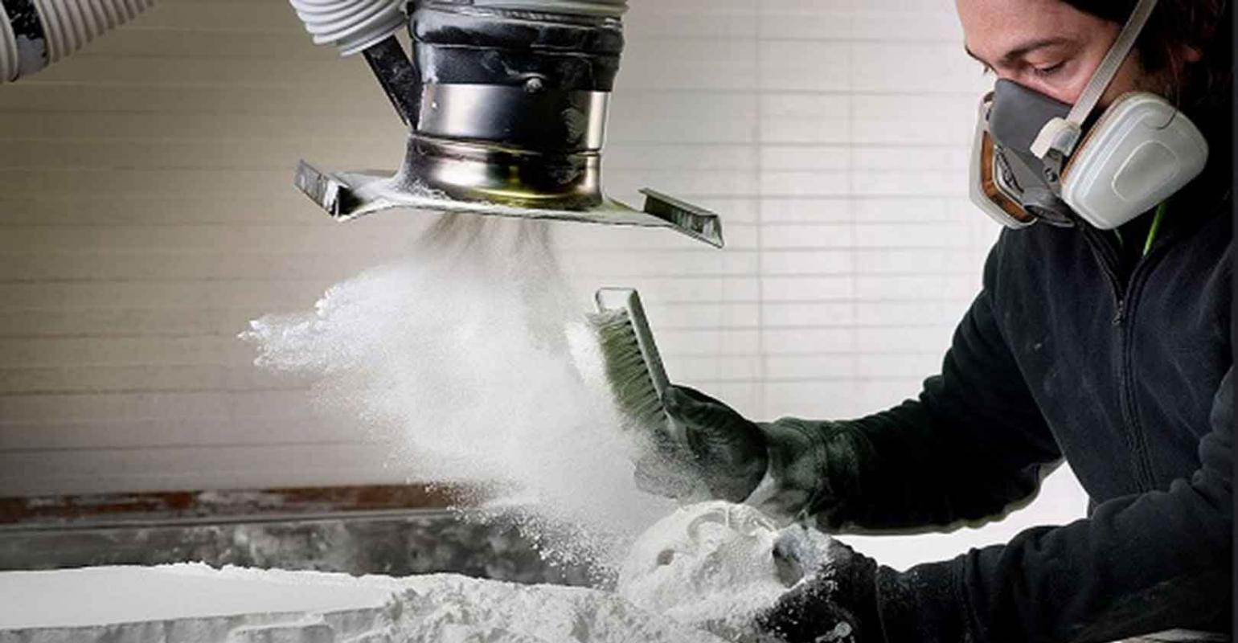
And depending on the AM process………
Post processing the printed item.
Can be a chemical bath to dissolve filament like a hinge build or supports.
Can be a sanding or smoothing process for filament prints.
Can be a UV oven curing process for SLA/SLS builds.
But it can be labor intensive.

Slide 40
What companies are Developing this technologies now?

Slide 41
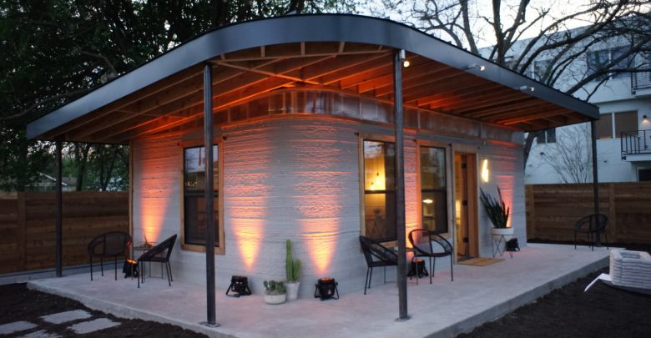
Can AM improve the environment?
Yes and one example is the 3D printed house designed and built by ICON. It is roughly 700 square feet and cost 4000 dollars and is built in 24 hours.
This is just one example of how energy can be conserved thru on site manufacturing. Instead of bringing all the materials together- in some cases from around the world- items can be printed on demand and where you are. No waiting on shipping.

Slide 42
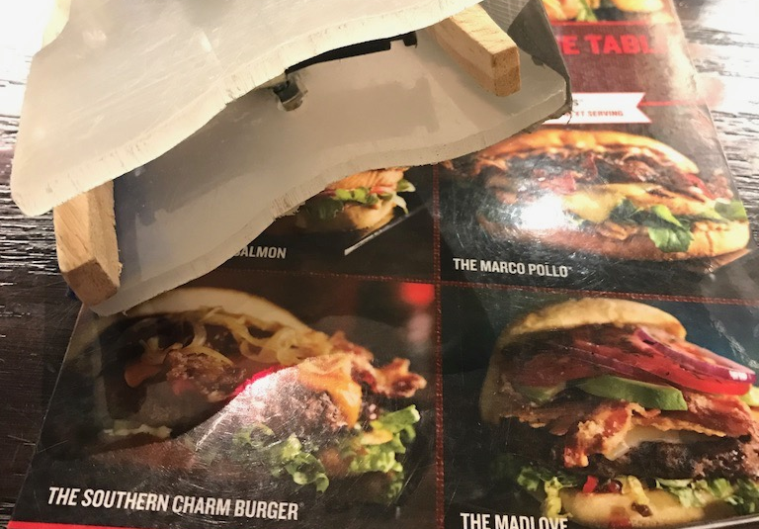
“Hamburger Helper” – Our ongoing journey to find a way for Veterans with limited hand mobility to enjoy a gourmet burger VA Puget Sound Health Care System
Can AM/3D improve the quality of life for someone?

Slide 43
Meet Paul and David: A shared goal, but different challenges
Both want to eat a burger without help
Paul needs to achieve this with hooks
David needs to achieve this with limited strength
Paul: “I want to be able to go on a date night to Red Robin and not have everyone stare at me while I try to eat a burger”
David: “I would like a solution where I don’t have to depend on others to feed me”

Slide 44
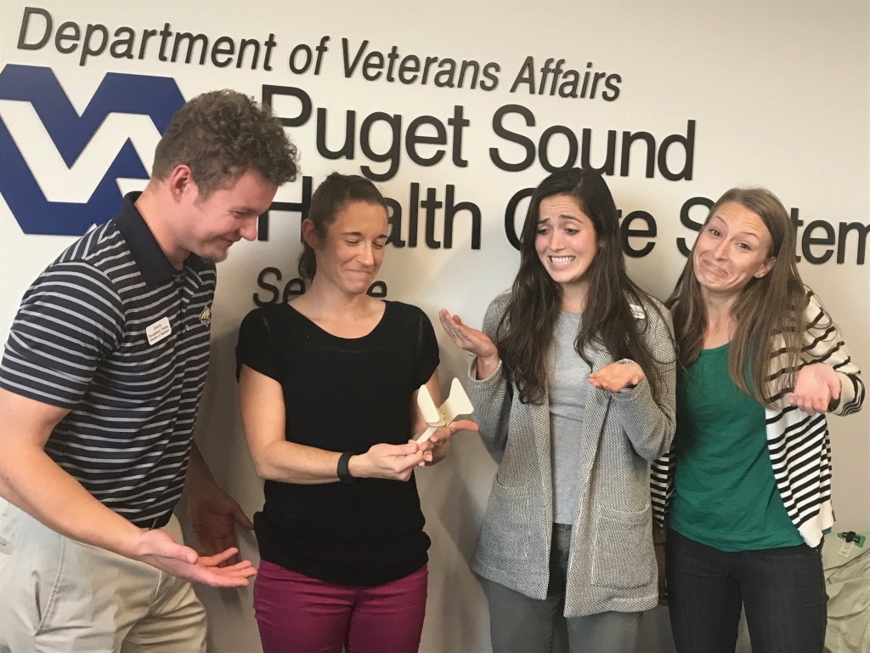
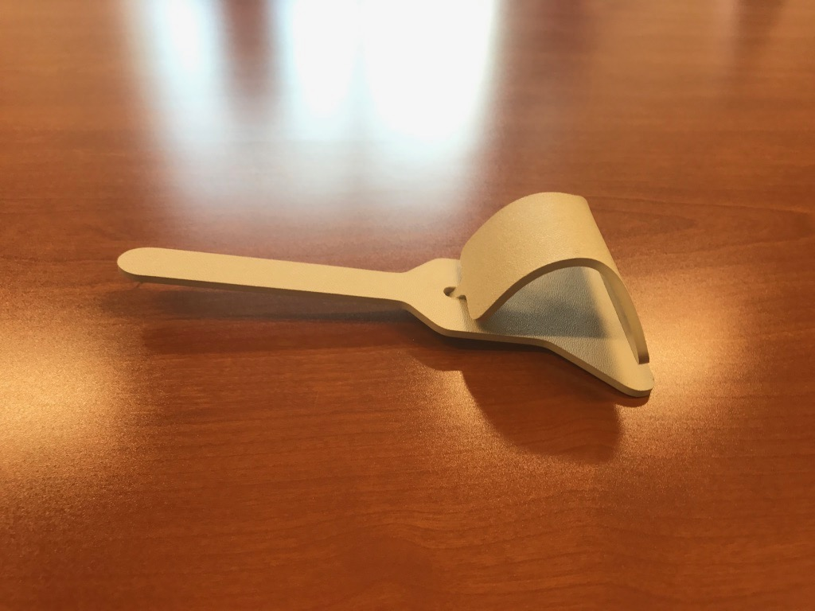
These Occupational Therapy Students signed up to use human-centered design to solve the hamburger problem
Current Option- Not the most useful or human-friendly design!

Slide 45
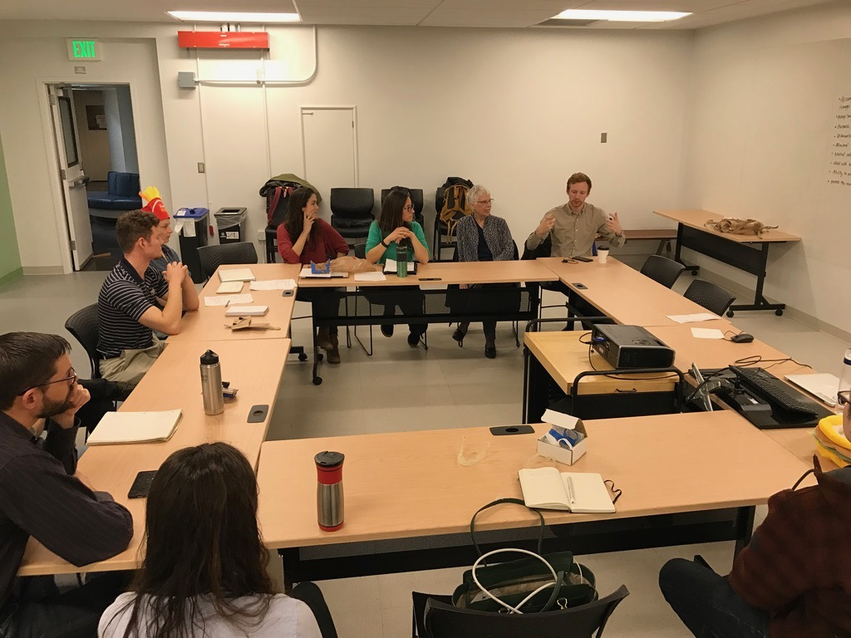
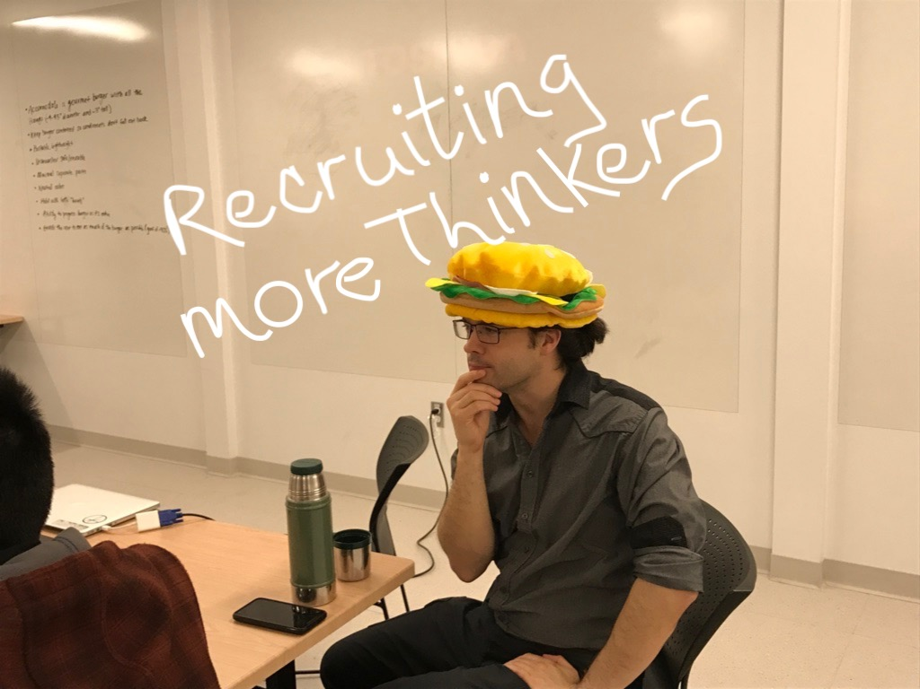
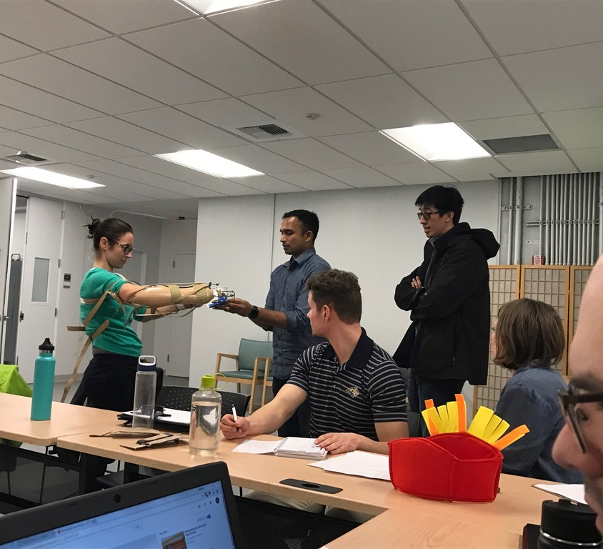
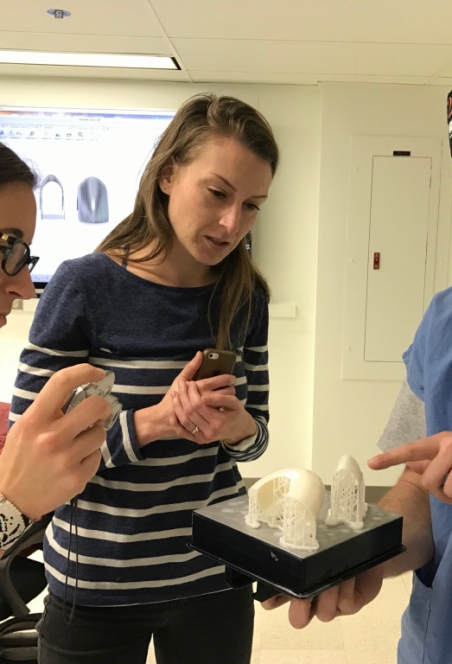
They built a team

Slide 46
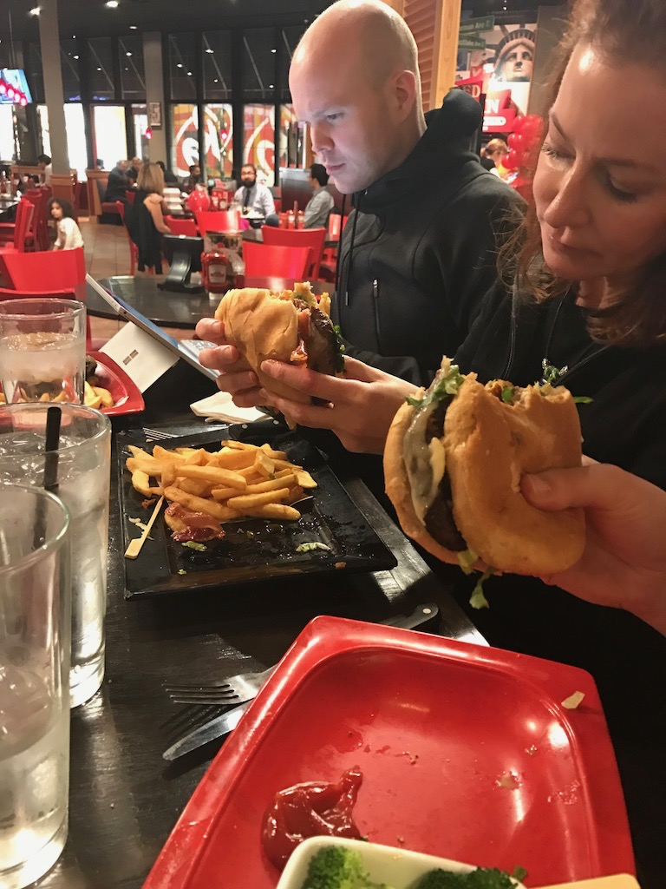
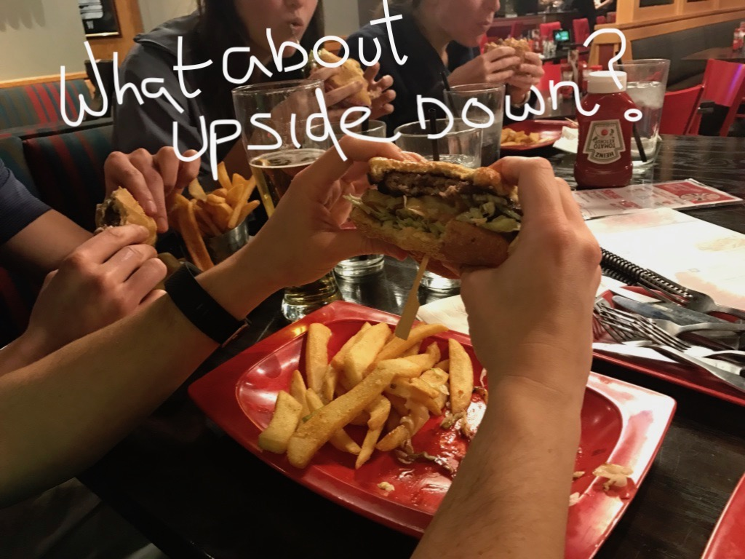
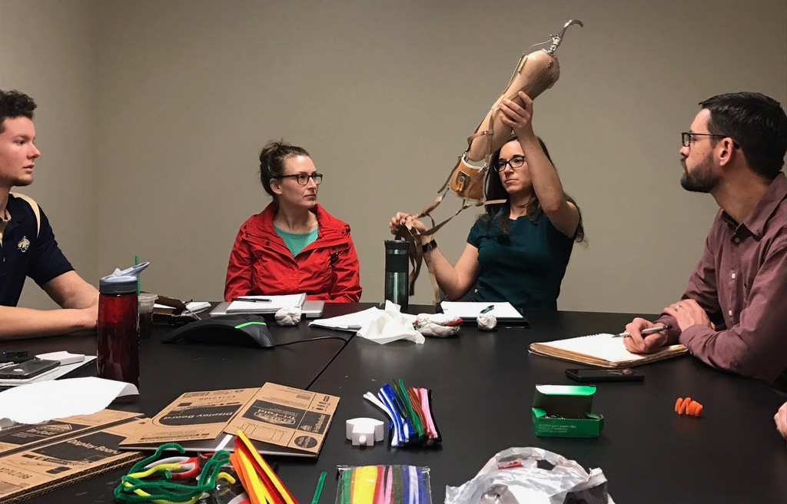
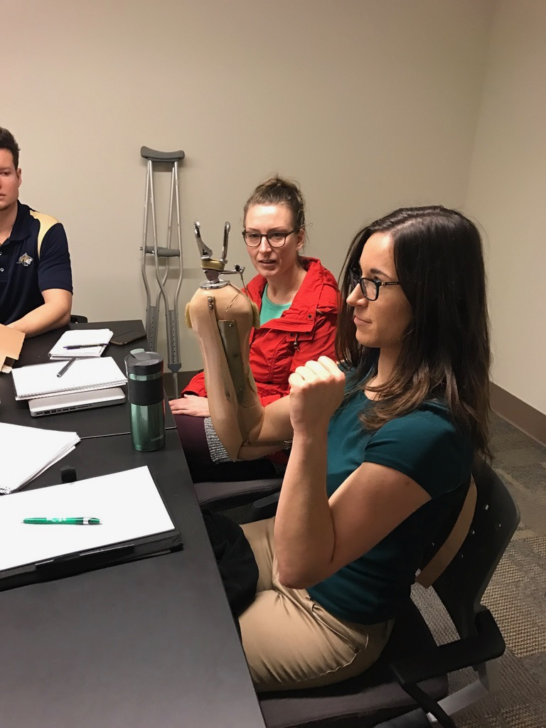
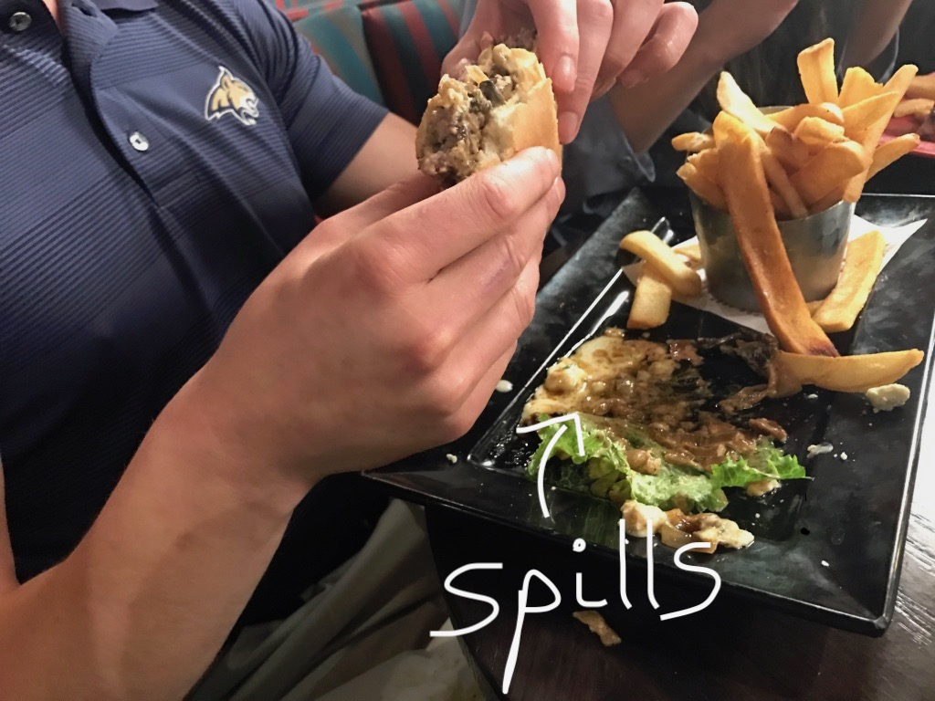
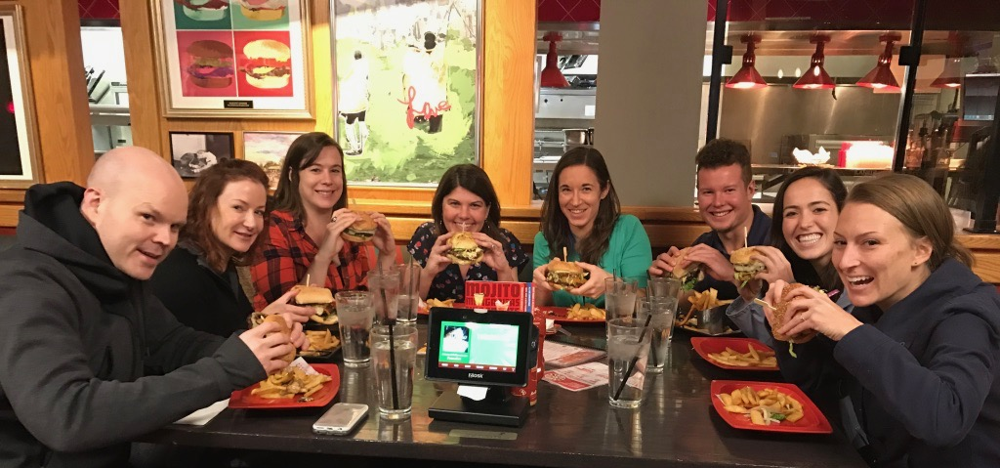
They Did Ethnographic Research

Slide 47
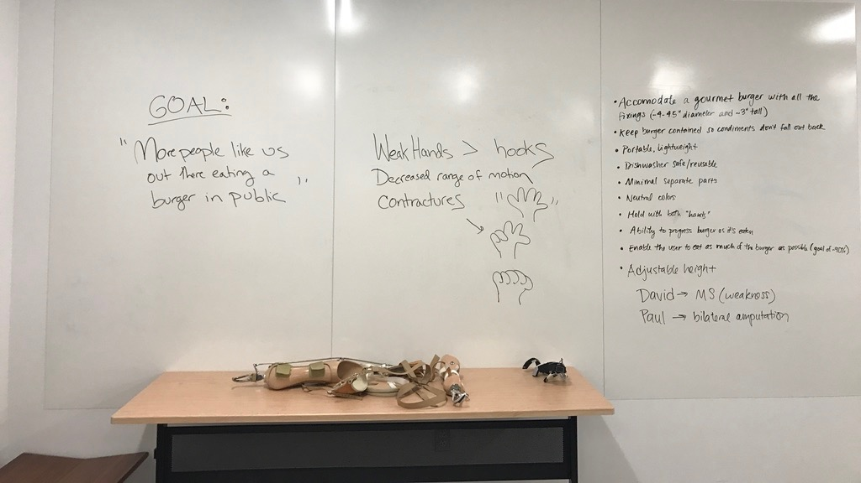
THEY FRAMED THE PROBLEM

Slide 48
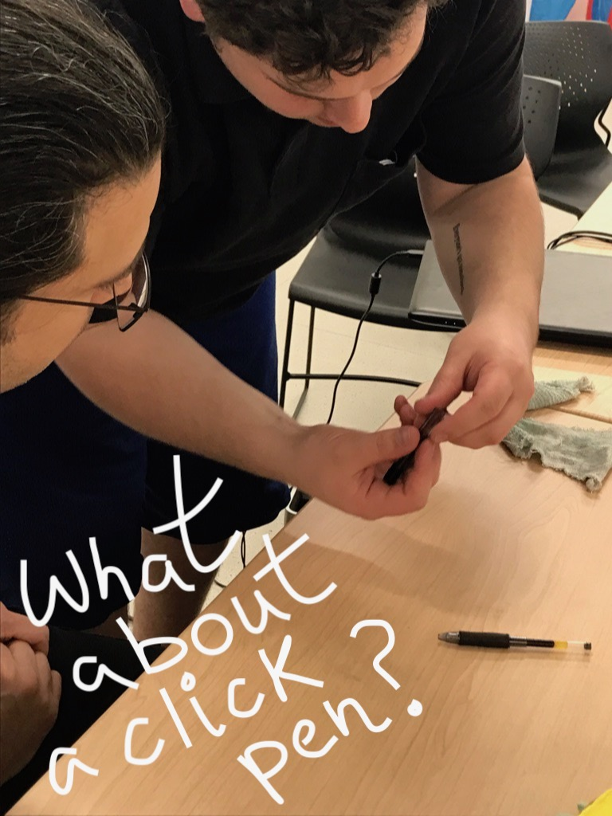
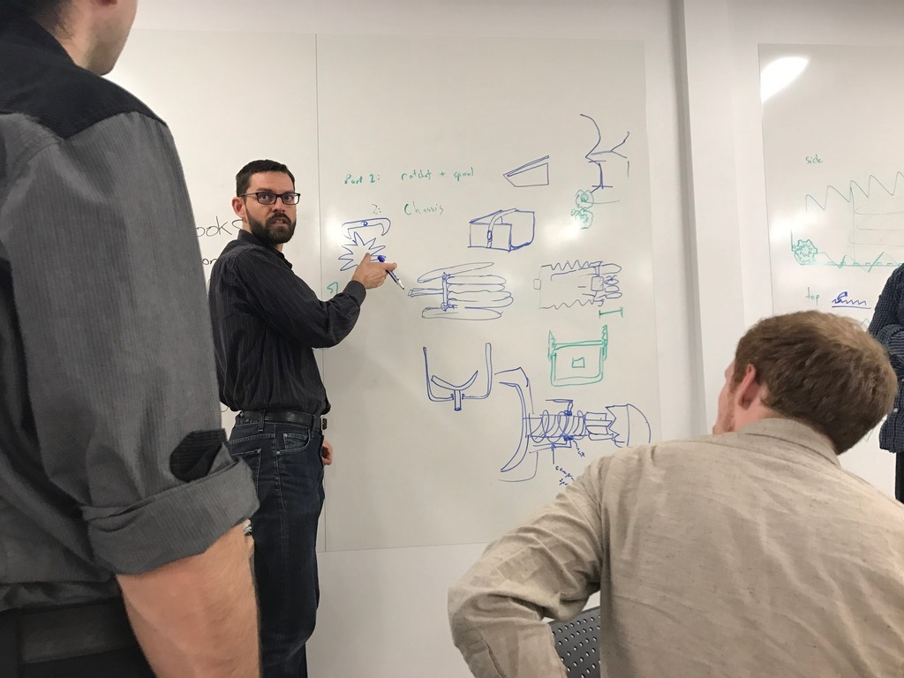
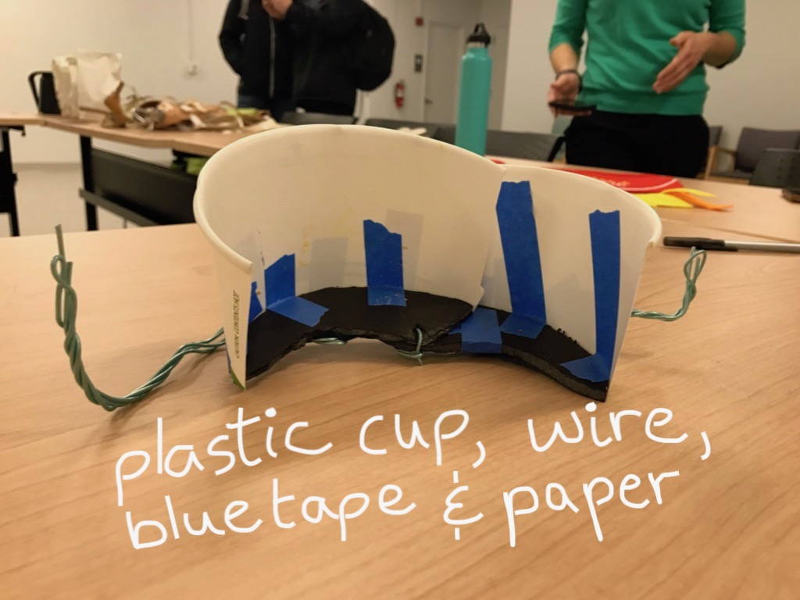
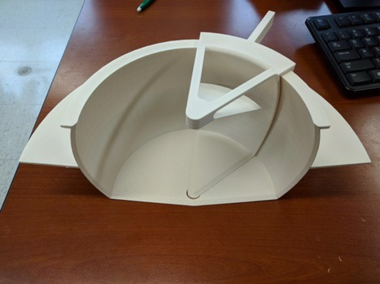
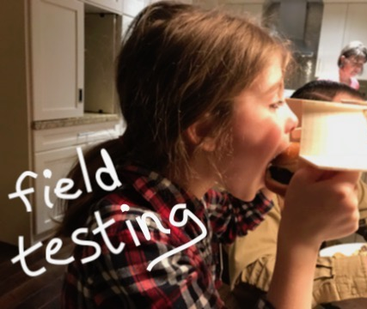
They generated lots of ideas and made prototypes

Slide 49
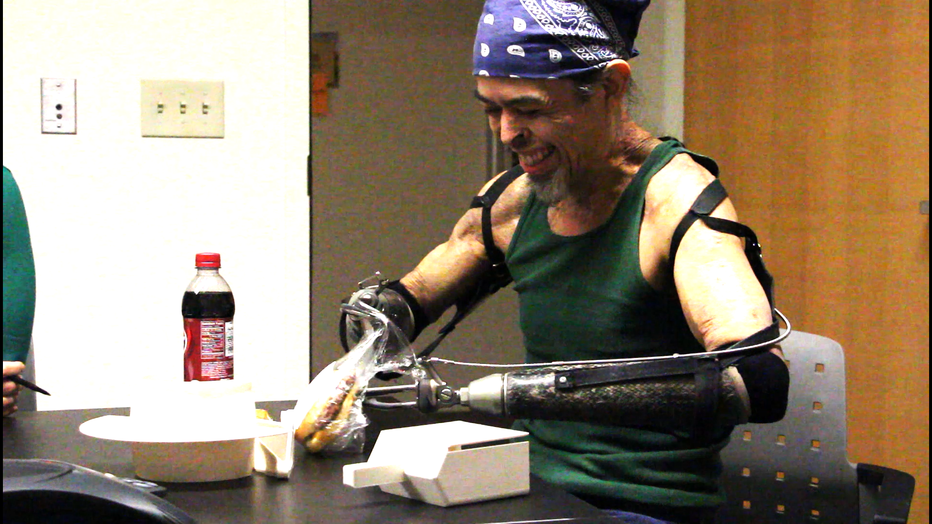
They took two prototypes back to the user for testing and feedback

Slide 50
Thanks for hanging out and possibly learning something new!
Thanks to The VA MADE Program for the show and tell objects.
Thanks to FormLabs for the Dental samples.
Thanks to Dr. Beth Ripley from the Puget Sound VA for the Hamburger Helper slides- and for being the AM champion for the VA.

